Slide 1
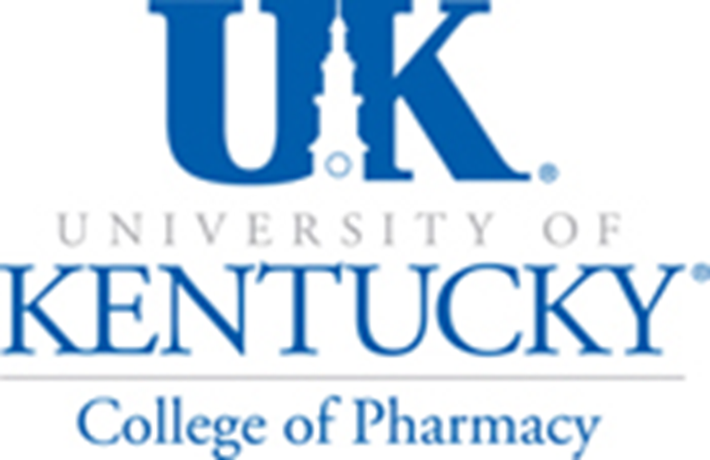

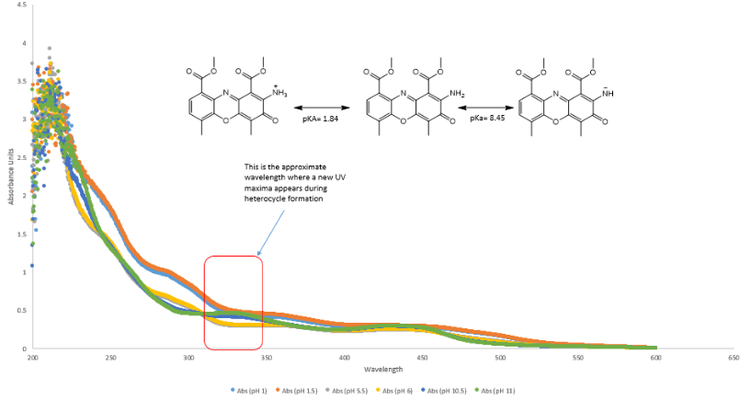
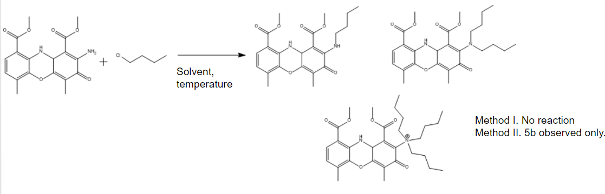
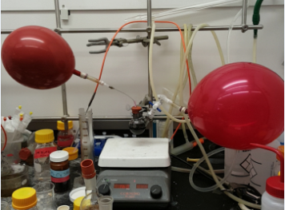
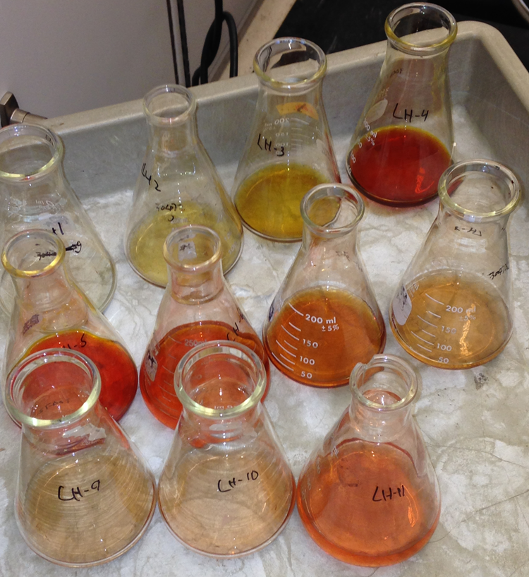
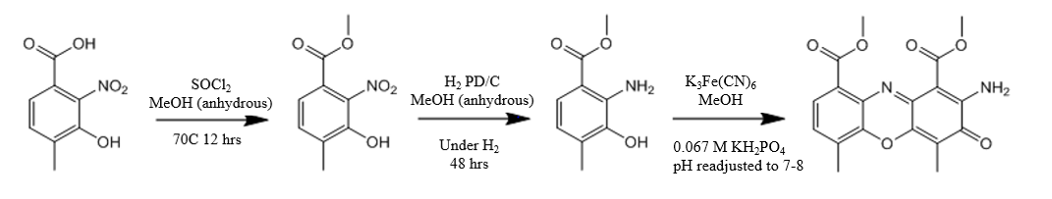
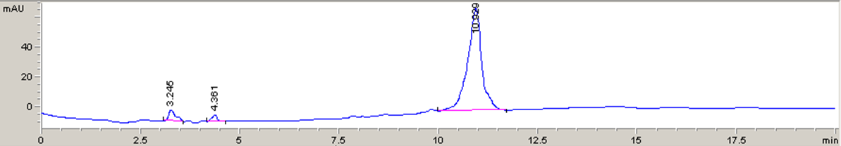
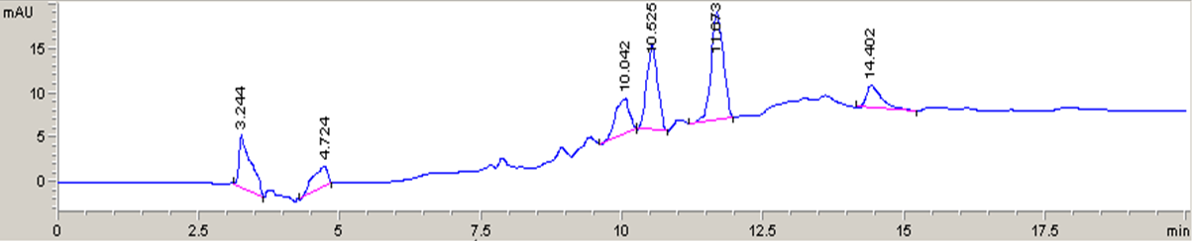
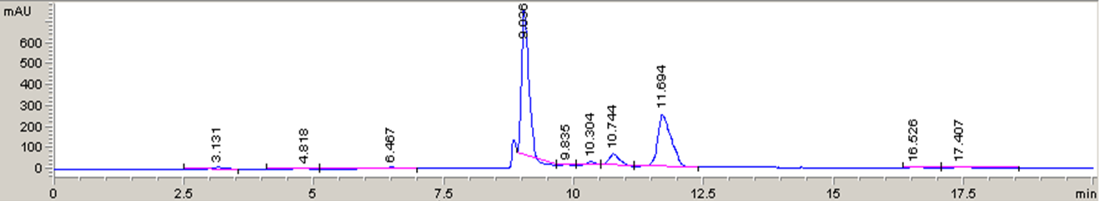
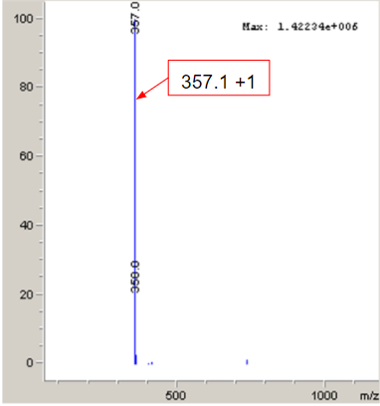
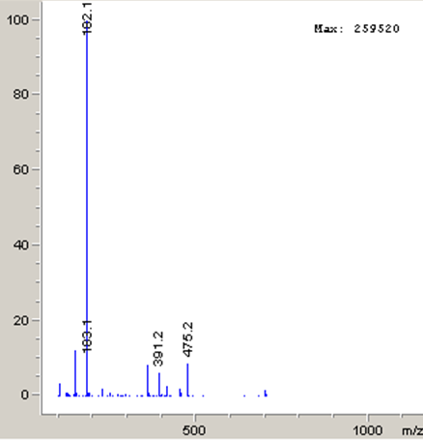
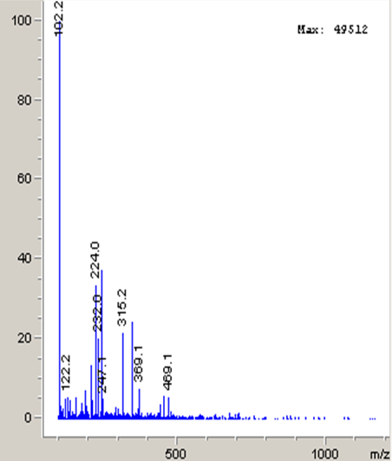
F
Determination of actinomycin Y1 aryl amine reactivity in the production of Y5
Aubree Zimmer¹, Matthew McErlean², Dr. Steven Van Lanen²,
¹Berea College, ²University of Kentucky College of Pharmacy
Introduction
Amine pKa Determination
Future Directions
Actinomycins are cytotoxic compounds produced by bacteria that function by intercalating into GC-rich sections of DNA and halting transcription. This mode of action is incredibly cytotoxic. There are 9 families of actinomycins which are all comprised of two amino acid rings (termed alpha and beta) attached to an aromatic core. There is variability among the rings, though not much difference in activity has been observed due to these alterations. In 2008, the actinomycin Y family was discovered. One compound, actinomycin Y5, was shown to have no detectable cytotoxicity while still maintaining antibacterial activity (Bitzer et al., 2008). This unique activity is believed to be due to a heterocycle formed by an amine linkage on the beta-ring. Due to Y5’s activity, this molecule may provide a potential scaffold for new antibiotics. In order to maximize the utility of this compound, the biosynthetic pathway of this compound needs to be better understood. Specifically, it is of interest to learn if this ring is formed enzymatically or spontaneously. We believe that a primary amine is responsible for this ring closure, though the reactivity of this particular amine is unknown. To further study the reactivity of this amine, we synthesized a simplified actinomycin core that does not contain the alpha and beta rings. We then determined the pKa of the amine as well as performed several alkylation reactions to show the reactivity. If this primary amine is shown to be reactive enough to be alkylated, then it is likely that the heterocycle may be formed spontaneously.
We successfully synthesized the actinomycin Y1 core, determined the pKa, as well as successfully alkylated the core showing this spot was nucleophilic. While the Method II conditions (DES) do make the aryl amine more reactive, the natural Y1 form is a better electrophile so the solvent was conducive to that nature. We hope to open future opportunities to derivatize and interrogate the reactivity of this molecule. We also hope this information on the biosynthesis of Y5 may give rise to future research in modifying the heterocycle to make Y5 more useful for medicinal purposes as well as provide a scaffold for future antibiotics.
Figure 3. Determination of the actinomycin core aryl amine pKa using UV/visible spectroscopy over a range of wavelengths.
Reaction Scheme: Alkylation
5a
5b
4
5c
Figure 4. Reaction scheme for the alkylation of the actinomycin core. Method I: H₂O, ACN, TEA, 60°C overnight. Method II: DES (1:2, choline:urea), 50°C overnight.
Results: Alkylation
Reaction Scheme: Actinomycin Core
a)
Figure 7. Images of actinomycin core reaction and isolation of actinomycins
10.880
Acknowledgements
1
70°C
2
3
4
I would like to thank the University of Kentucky College of Pharmacy summer undergraduate research program as well as the Van Lanen Lab group, especially Steven Van Lanen and Matthew McErlean, for providing this great opportunity.
a)
Figure 1. Synthesis of the simple actinomycin “core” with no alpha or beta rings.
b)
10.042
9.036
Figure 5. a) HPLC trace of the Method I alkylation on a C18 column. b) HPLC trace of the Method II alkylation on a C18 column.
References
b)
a)
b)
Figure 6. a) LC/MS data of the Method I alkylation which did not result in predicted products. b) LC/MS data of the Method II alkylation which resulted in only product 5b, the di-alkylated product.
Bitzer, J. et al., First Y-type actinomycins from Streptomyces with divergent structure-activity relationships for antibiotic and cytotoxic properties. Organic & Biomolecular Chemistry (2008).
Figure 2. Confirmation of the production of the actinomycin core. a) HPLC trace, elution time 9.036 minutes. b) LC/MS data, actinomycin core mass (357.1+1) observed.
No product observed
468 +1
Product 5b

