Slide 1

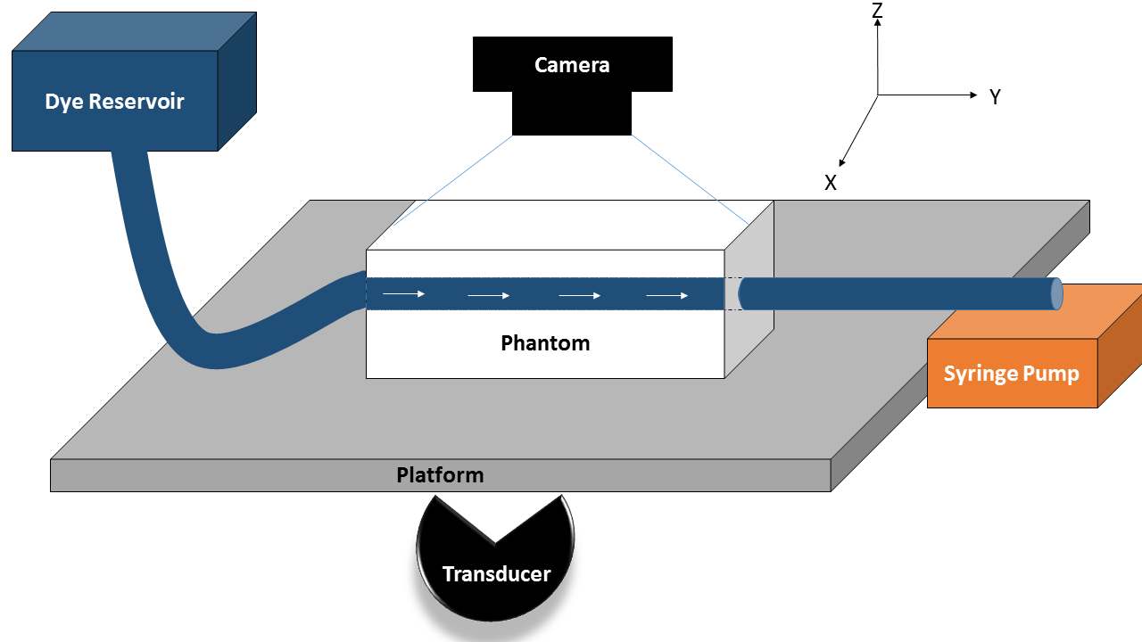
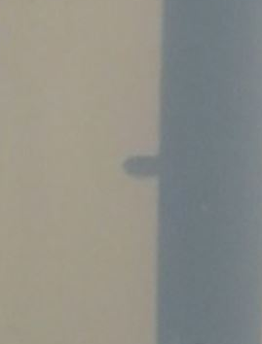
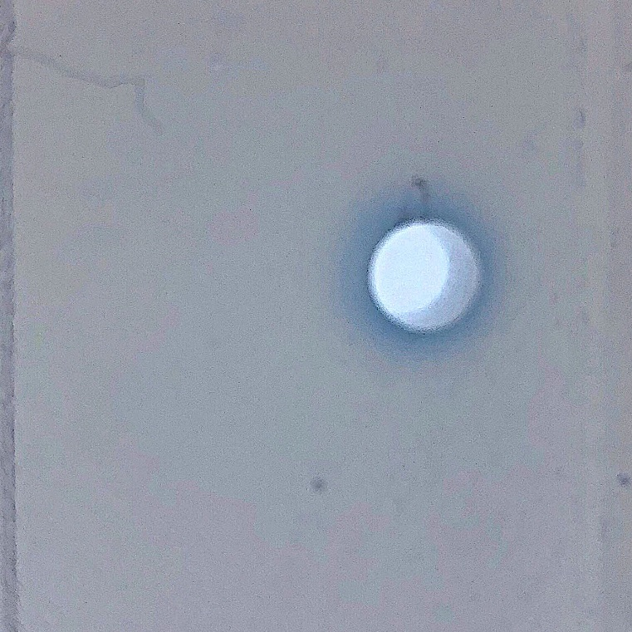
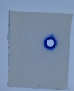
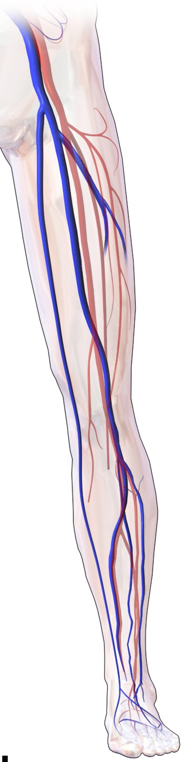
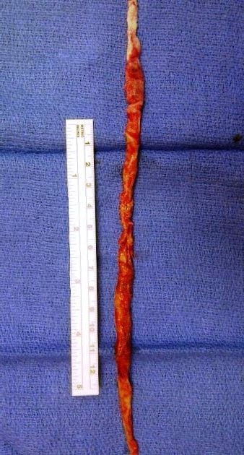
Investigating the Efficacy of Histotripsy on Drug Delivery
Heather Thompson, Kenneth Bader
University of Chicago, Department of Radiology, 5801 S Ellis Avenue, Chicago, IL 60637
Therapeutic ultrasound has the potential to be developed into a non-invasive tool that can be used to advance drugs into cancerous tissue and deep vein thrombi using histotripsy, a focused ultrasound that uses microbubbles. Using the mechanical action of microbubble clouds produced by histotripsy, we hypothesized that such action will improve drug delivery methods by increasing penetration and diffusion of therapeutic drugs. The effects of histotripsy on drug-delivery was investigated by administering Evans Blue Dye through a flow loop located in an in vivo agar phantom. The agar phantom was used to mimic the tissue-fluid interface between thrombi and blood within a vessel. The phantom was subjected to an ultrasound that produced different peak negative pressures with the same pulse duration and frequencies in order to produce microbubbles. Dye was administered to model the diffusion of chemotherapeutic or thrombolytic agents in order to indicate the effect of histotripsy on the diffusion of drugs. A camera was used to document the diffusion of dye throughout the flow phantom in order to quantify the extent of drug delivery. Modeling the perfusion of therapeutic drugs proved to be inconclusive given the noise present from the passive diffusion of the dye although a protrusion was observed. Quantifying the extent of drug delivery is a fundamental step in understanding the means by which histotripsy can be used to improve treatment of disease pathologies such as deep vein thrombosis and cancer.
Motivation and Introduction
Methodology
Results and Further Work
.
APPARATUS
RESULTS:
MOTIVATION
A saline-agarose phantom and water tank were degassed before the Evans Blue Dye was administered. After degassing, the transducer (Des Plaines) and imaging array (Verasonics L11) were leveled, and the focus of the imaging array was established. The transducer was rotated 90 degrees to face the side of the tank where the imaging array was manipulated by hand until the focal point was established at (0,65) using the grid on the imaging window in MATLAB. The platform was lifted out of the tank in order to mount the phantom and connect the flow loop in which Evans Blue could be administered. Evans Blue was placed into the syringe where it would be allowed to flow through the phantom at a constant rate of 3.08 ml/min produced by a syringe pump. The focal point of the imaging array was realigned once the flow loop was connected to the phantom. A Nixon D3400 was then mounted above the phantom to document the movement of the dye.
A protrusion was observed in eight out of ten phantoms. When cavitating at the proximal, center, and distal portions of the channel, the protrusion phenomena varied between phantoms and site of insonation. Overall, this occurrence transpired at the proximal portion three times, the center four times, and the distal portion once. Likewise, the protrusion was towards the direction of the ultrasound, opposite of the pressure wave propagation. This occurred in seven of the eighth instances.
Deep vein thrombosis (DVT) is a major public health problem, affecting 5% of the population and costing an estimated $10 billion in healthcare in the United States. DVT can result in the amputation of limbs and an increase in mortality rates due to critical obstruction within the veins. For critical venous obstructions, catheter-directed thrombolytic drugs are the frontline therapy for recanalization; however, adverse effects such as pulmonary embolism and incomplete removal are characteristic of this method. Recent studies show therapeutic ultrasound can be used as an non-invasive instrument that can ablate tissue, including thrombi. Therapeutic ultrasound has the potential to improve penetration and diffusion of thrombolytic drugs, lowering the likelihood of re-thrombosis. This application can also be applied to anticancer therapeutics. Despite the leaky vasculature characteristic of tumors, anticancer therapeutics are unable to penetrate further than 50 μm beyond the blood vessel. This is in part due to the excessive reliance on the enhanced permeability and retention (EPR) effect for passive accumulation of the therapeutic agent. It is believed that using the mechanical activity produced by the ultrasound can increase the penetration and diffusion of anticancer therapeutics into the cancerous tissue.
Evans Blue
Protrusion
Figure 2: Experimental Setup for Insonation. Shown is the schematic design of the experimental layout. The water tank was not drawn for simplicity reasons. The transducer was able to move because of the three axis positioning system.
Phantom
Figure 4: Protrusion Phenomena. This “blip” occurred when the site of insonation was at the center of the channel. The parameters for this insonation can be viewed in Table 1.
Figure 5: Cross-Section Cut of Phantom. When slicing the phantom with respect to the fiducial markers, protrusion was noted at Section C, Cut 2 with respect to Figure 3.
Figure 6: Gross Image of Phantom. Despite reducing the dye concentration, the signal to noise ratio was too great to accurately concluded a relationship between histotripsy and drug-delivery.
INSONATION
Chronic, Fibrous Thrombus
Cut 3
Cut 2
Cut 1
Site
The transducer was moved to where the focal point was on the proximal side of the channel. Using the imaging window and a script that moves the positioning stage in MATLAB, the transducer was moved along the fiducial markers while the platform was adjusted in order to be level with the transducer and the imaging array. The focal point was then readjusted with respect to the channel located within the phantom. The transducer and imaging array moved along the positioning system so that the focal point was placed on the channel at the positioning of (0,65). Once the channel was located, the x and z coordinates were zeroed to make this position a reference point. The transducer and imaging array was moved along the phantom to find the fiducial markers, the sites of insonation. To begin insonation, commands were called within MATLAB that allowed for the establishment of the parameters: peak negative pressure, voltage, number of cycles and pulses, and pulse repetition. Once ran, the transducer began creating cavitation at the designated site. The transducer and imaging array was then moved to the next site of insonation using absolute movements while the B mode imaging file was saving.
The profusion of ultrasound on drug-delivery was inconclusive given the inability to accurately quantify the data from the gross images. A script was written in MATLAB that attempted to measure the surface area and diffusion distance; however, processing and analyzing gross images taken by a Nixon D3400 proved problematic. This was because the signal to noise ratio was too large. This script can be modified to accompany other imaging acquisition techniques.
Femoral
Vein
Overhead View
D
C
B
A
Section
Thrombus
Ineffective for Chronic Thrombus
Direction of Flow
Acute Thrombus
Site of Insonation:
Catheter Directed Thrombolytic Therapy
FURTHER WORK:
The protrusion proved promising for using histotripsy to increase profusion of therapeutic drugs since this showed mixing of fluid within an area of ablation. However, a substance of a greater molecular weight that closely resembles therapeutic drugs should be used to maximize the effects of cavitation on perfusion. Likewise, another technique such as microscopy should be used to obstruct gross images of a greater focus that can be processed with greater accuracy.
Efficacious for
Acute Thrombus
Transducer
Figure 1: Illustration of Catheter-Directed Thrombolytic Therapy. This technique proves ineffective for chronic thrombi given the methodology of the procedure. This results in fragmentation of the thrombus and an increase in the likelihood of re-thrombosis.
WHAT IS HISTOTRIPSY?
Figure 3: Schematic Diagram of Insonation along Phantom. The transducer was moved along the channel in the direction of flow, insonating at the proximal, center, and distal portions of the channel.
Acknowledgements
Histotripsy is a form of therapeutic ultrasound in which acoustic energy generated by a transducer is focused on a targeted volume inside the body. The delivery of acoustic energy is in the form of short (<10 microseconds), very high intensity pulses that induce extreme pressure change. Cavitation is a process that occurs when a sufficiently negative pressure is applied to a tissue to cause microbubble formation from fluid vaporization and release of dissolved gas. Microbubble clouds are only initiated whenever the peak negative pressure in an acoustic waveform exceeds an intrinsic threshold which is around 25 MPa in most tissue. The bubbles exhibit dynamic patterns of oscillations and inertial collapse which imparts severe stress on the surrounding cells and tissues, producing cellular and tissue fragmentation. They become excellent sound reflectors that appear as areas of hyperechoic zones with ultrasound imaging. This allows accurate targeting for localization and real-time monitoring.
I would like to thank the Office of Internships at Berea College for funding my eight week experience at the University of Chicago. Without this generous donation, this experience would not have happened. I would also like to thank the Department of Radiology at the University of Chicago for giving me the opportunity to investigate the method of histotripsy and learning more about acoustical physics. Finally, I would like to thank Dr. Kenneth Bader and his associates for mentoring me throughout my experience.
Peak Negative Pressure (MPa) | Pulse Repetition (MHz) | Number of Cycles | Number of Pulses
25 | 20 | 5 | 2000
Table 1: Parameters for Cavitation. These parameters were selected to ensure cavitation would occur and mimic those used on the body to ablate tissue or thrombi.
References
[1] Bader K B, Haworth J B, Shekhar H, Maxwell A D, Peng T, McPherson D D and Holland C K 2016 Efficacy of histotripsy combined with rt-PA in vitro Phys. Med. Biol. 61 5254-5265.
[2] Maxwell A D, Wang T, Cain C, Fowlkes J 2011 Cavitation clouds created by shock scattering from bubbles during histotripsy J. Acoust Soc Am. 130 1888-1898.
Notes:
. Mechanical embolectomy has been employed as an adjuvant to the catheter-directed thrombolytics. Chronic thrombi can fragment during this process causing incomplete thrombus removal, pulmonary embolization, and a high likelihood of re-thrombosis.

