Slide 1




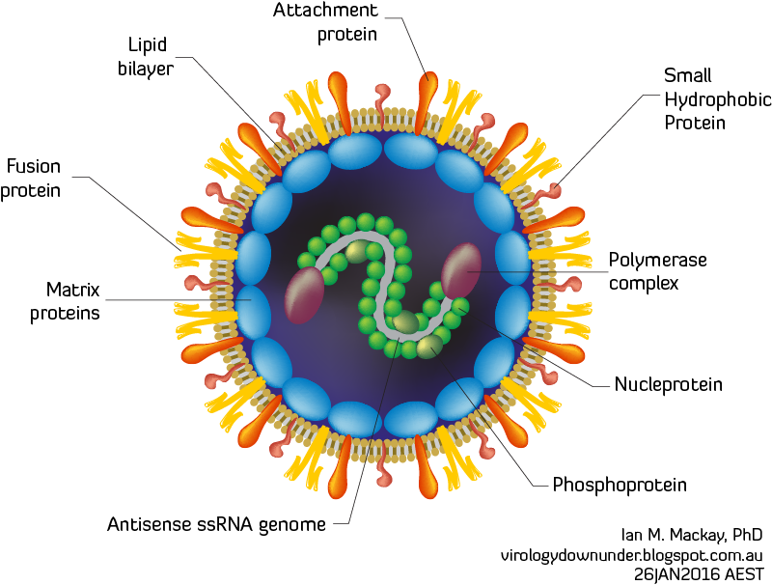
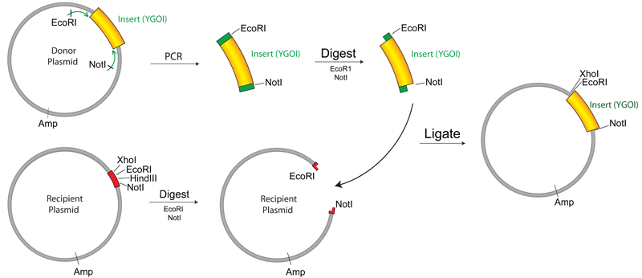
Inhibiting Human Metapneumovirus (HMPV) F Protein Activation through Transmembrane Serine Proteases
Amber Earlywine^{1,2}, Tyler Kinder³, Rebecca Dutch Ph.D^{1,3}
¹NSF REU program, Lexington, KY; ²Berea College Department of Chemistry, Berea, KY; ³Department of Cellular and Molecular Biochemistry, University of Kentucky Lexington, KY
Human Metapneumovirus (HMPV) is a respiratory pathogen that was discovered in 2001, within the pneumoviridae family. It has become an important research topic because of its symptoms of severe acute upper and lower respiratory virus in children, the elderly, and the immunocompromised. HMPV has several surface glycoproteins shown in Figure 1. However, the only one that has shown to be necessary for viral transmission to other cells is the Fusion protein (F protein).
Figure 2.
Cleavage event caused by activation of the F protein by Heparan Sulfate Proteoglycans and a host cell protease
Because of the importance of the F protein, it can be determined which proteases bind and cause cleavage. The goal of this project was to test if different proteases such as HAT (TMPRSS11D), TMPRSS2, TMPRSS4, Matriptase, KLK5, or KLK12 cleave the F protein so that a protease inhibitor can be used to stop viral spread. Although the project focused mostly on TMPRSS2 and TMPRSS4.
Figure 3. Life cycle of HMPV F protein within host cell
Methods
Western blot analysis demonstrates presence of TMPRSS4 insert after PCR reaction
Introduction
Figure 4. Cell culture process and expected Western Blot Analysis
Figure 5. Western Blot Analysis
TMPRSS2 ran on a 10% gel at 10ug concentration
with the HMPV F protein.
Trypsin was used as a positive control for the
cleavage of the F protein.
gure 6. PCR Cloning process to sub-clone the TMPRSS4 insert from a pcDNA plasmid to a pcAGGS plasmid.
TMPRSS4 Insert
-
+
RXN Vol. 20 20 50 50
Template DNA 50 250 50 250
TM4
F0
pcAGGS
F1
Transfection
Lysis
Figure 1.
HMPV virion showing surface glycoproteins such as F, M, SH, and attachment proteins
Figure 7. Western blot of TMPRSS4 insert in varying concentrations
Future Directions
S
S
Test expression of TMPRSS4 in pcAGGS after sub-clone and test if it cleaves HMPV F
Using a protease inhibitor to stop activation of F protein and prevent further viral spread
Using a protease inhibitor as a natural therapeutic for those who are already infected
FP
HRA
HRB
TM
F2
F1
Conclusion
Based on the Western blot analysis, it can be presumed that TMPRSS2 cleaves the F protein in HMPV and can potentially be inhibited. There is not enough evidence to conclude whether TMPRSS4 cleaves the F protein or not, but future experiments could provide this answer.
References
Acknowledgments
I would like to thank the Dutch Lab, the University of Kentucky NSF REU program, and the Berea College internship office for allowing me to have this internship experience. Also, great thanks to the Dutch Lab for their guidance on this project and to Tyler his mentorship.
Plasmid Cloning by PCR. (n.d.). Retrieved July 18, 2017, from https://www.addgene.org/protocols/pcr-cloning/
https://www.ncbi.nlm.nih.gov/pubmedhealth/PMHT0025751/

