Slide 1
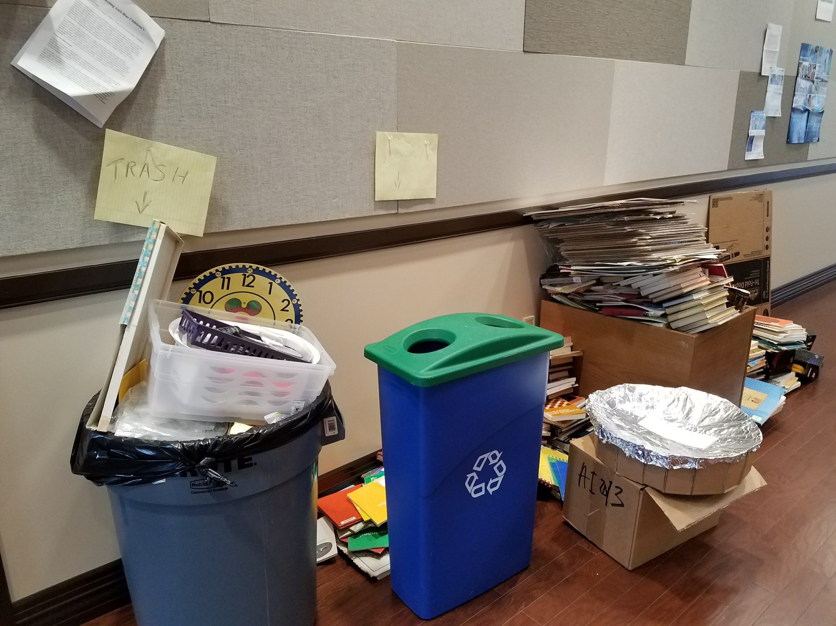
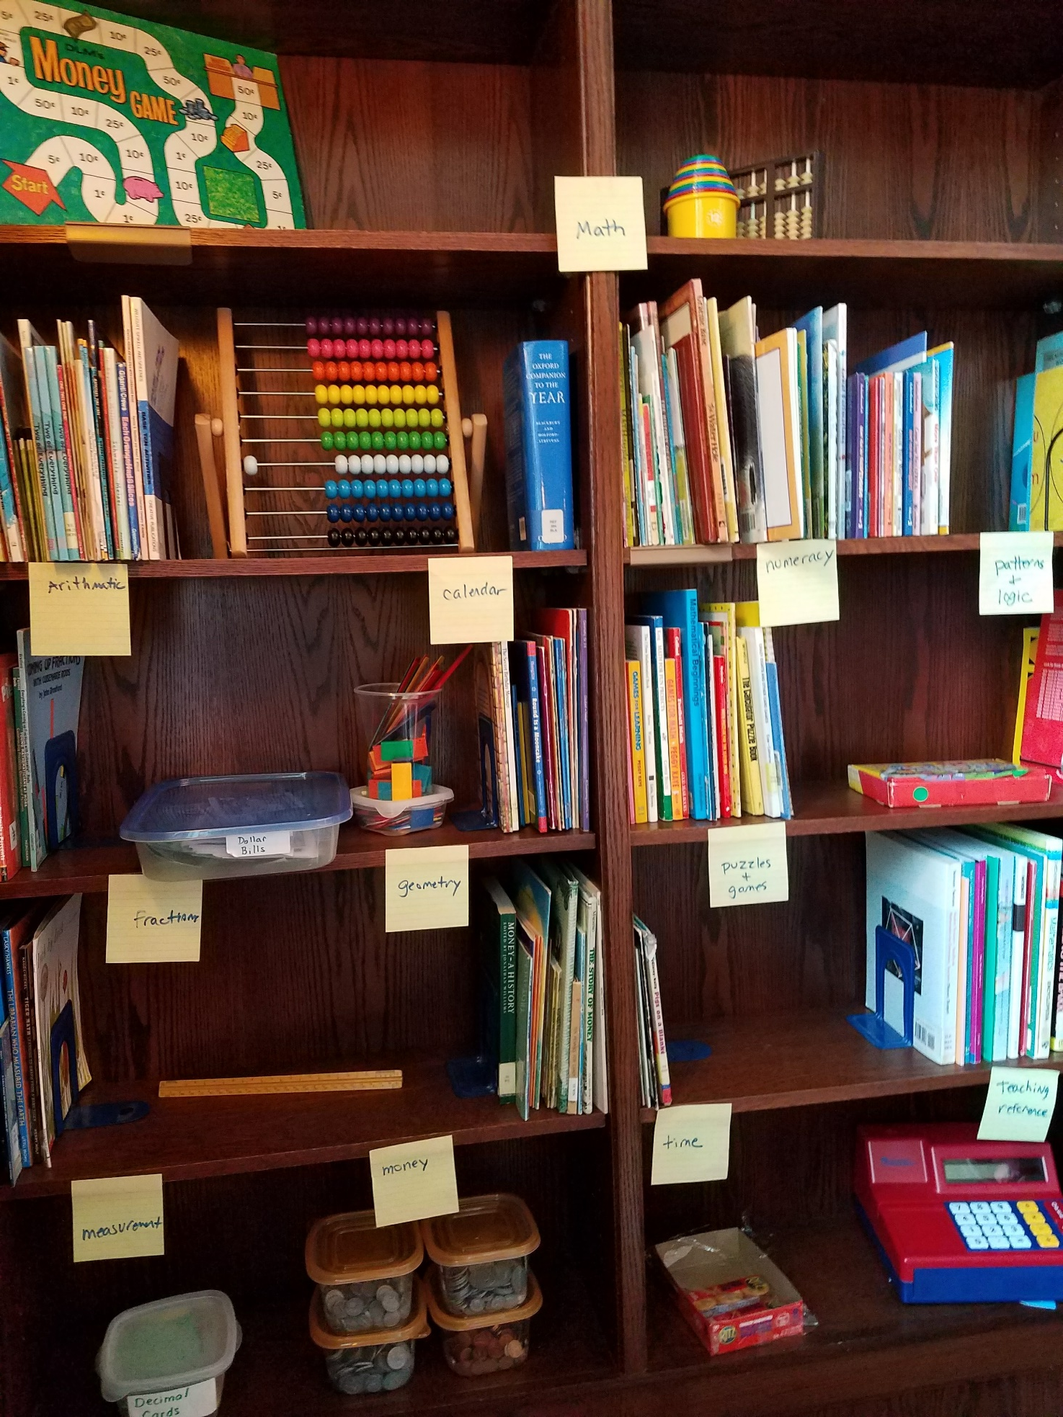

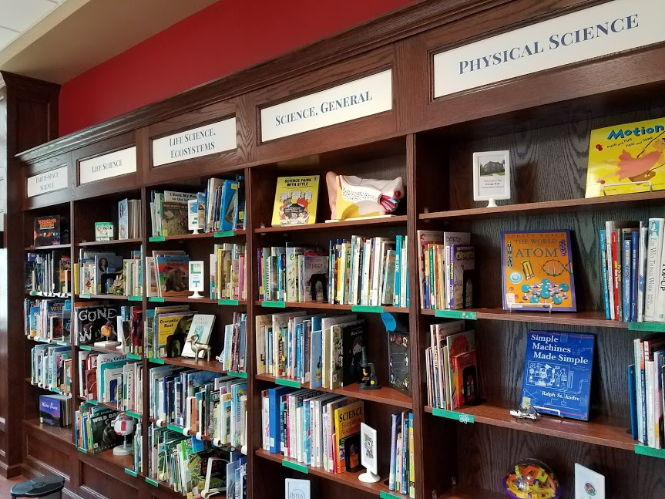
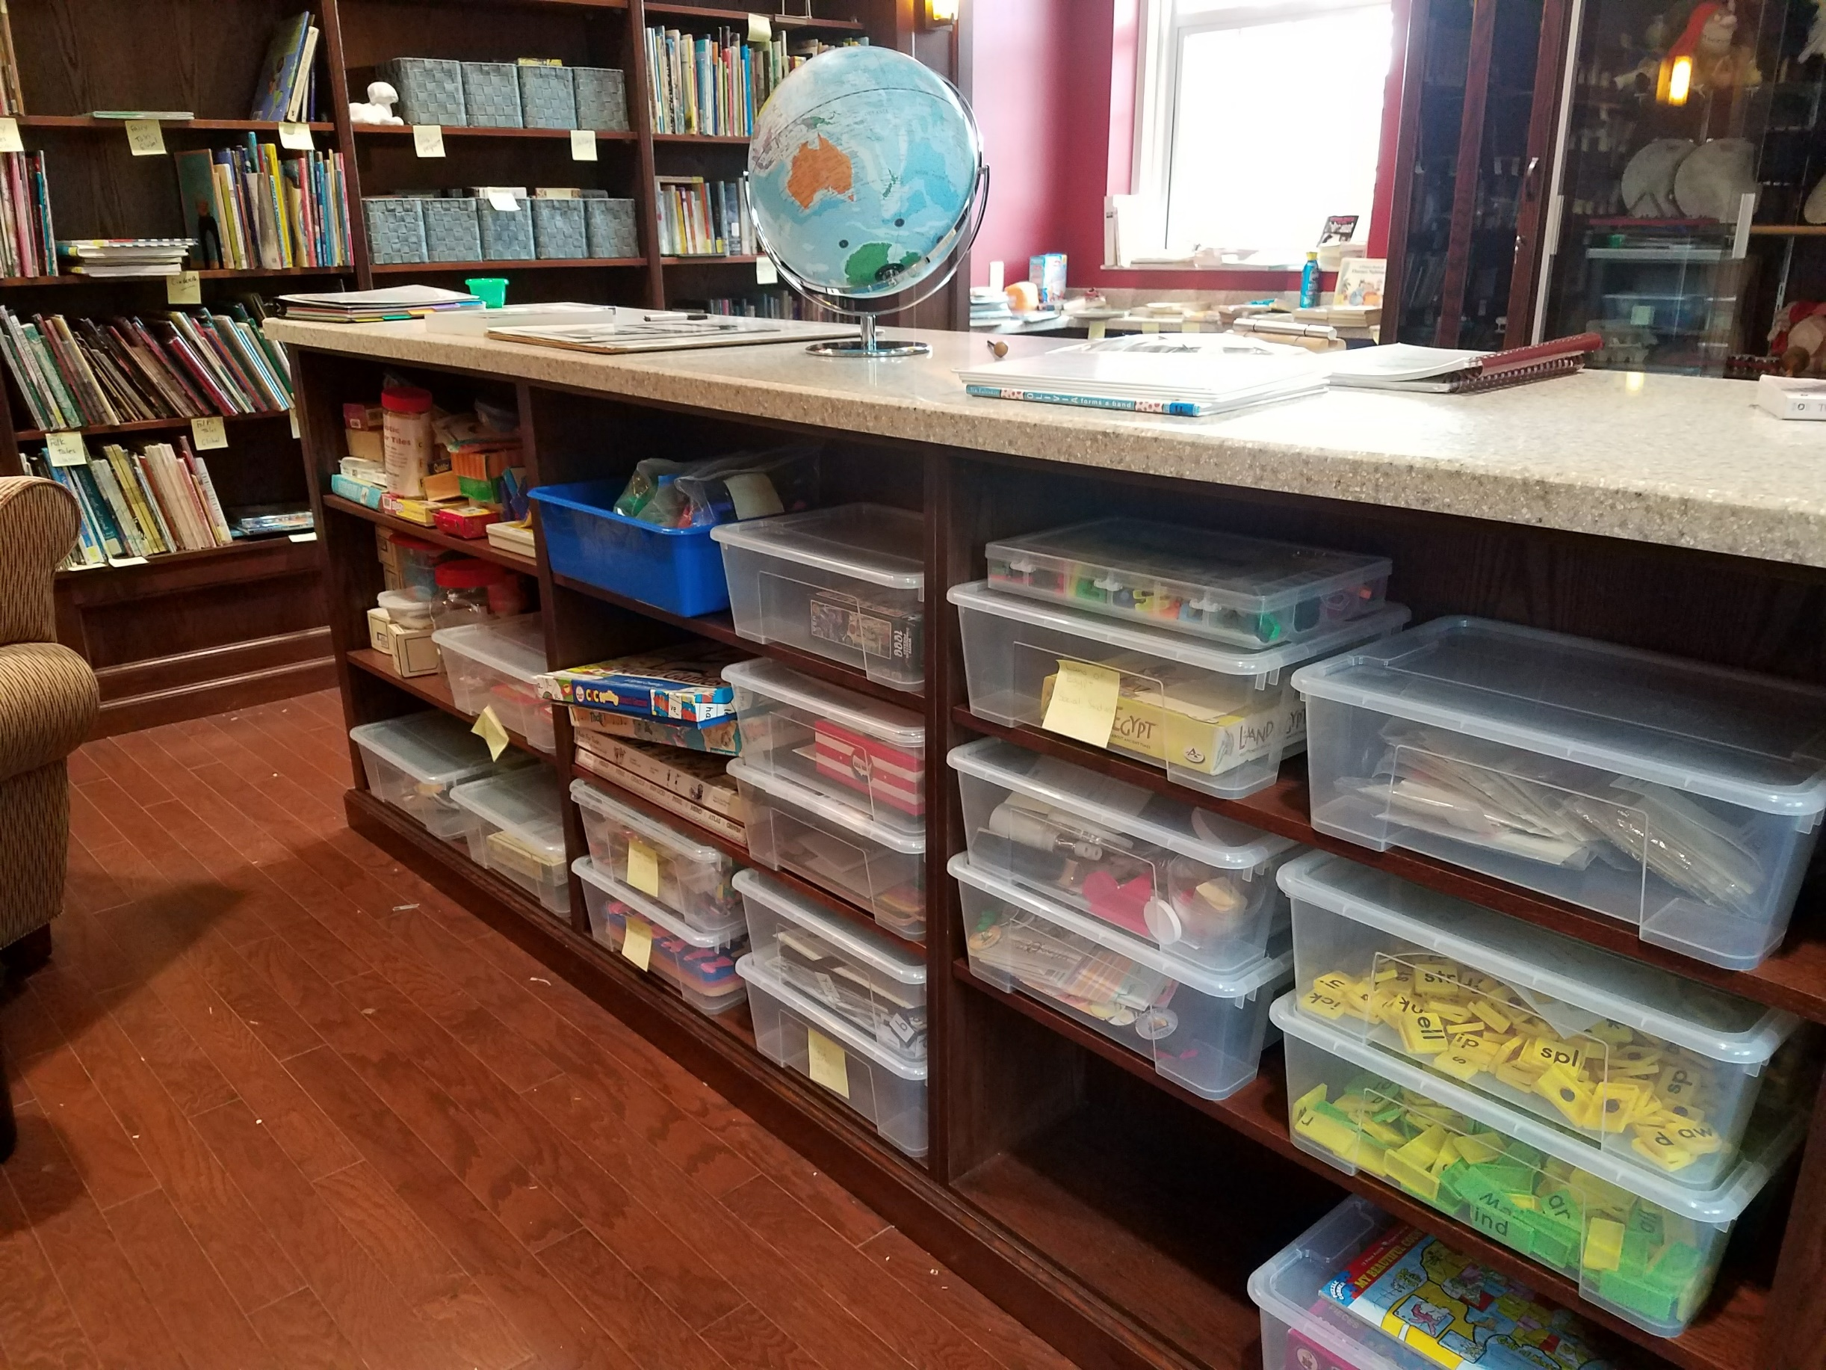
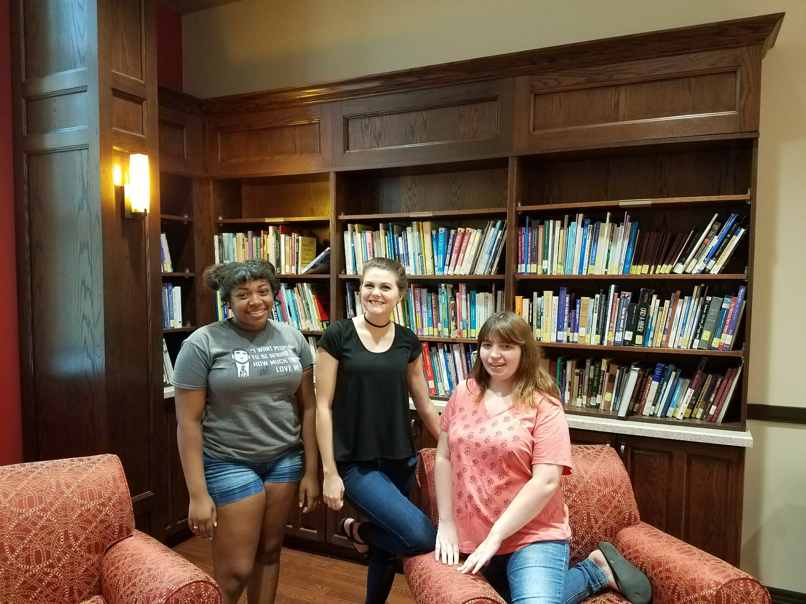
Problem
The organization of the Knapp Hall Curriculum Library made it difficult for patrons to find the materials they were looking for. Many of the best books and teaching tools were hidden by books dating back half a century.
Lit Review:
There are dozens of different library organizational systems
There is limited published research on organizing curriculum libraries
Dewey Decimal Classification system (DDC) is commonly used but is biased (gender, race, religion) and is difficult to navigate
Reorganizing is an enormous task which discourages change
Survey
Assessed library usage and needs of education students, professors, faculty members, and community teachers.
15 student responses, 6/7 faculty and staff responses, about 20 community teacher responses
Process
Categorized and color-coded all texts into Math, Science, Social Studies, ELA, SEL, and the Arts
Further organized texts into instructional themes
Altered categories as needed until most books had a definite category
Purchased new texts for underrepresented sections
Organizational Changes
Color-coded all manipulatives in clear containers
Sorted leveled readers in reading-level specific baskets
Labeled and mapped all categories
Reused old manipulatives as props on shelves
Weeding
Outdated
Culturally/racially insensitive
Pre-school level
Outside of K-12 content areas
Torn/water damage
Future Research
We intend to create a second survey for patrons to evaluate how well our system is working.
The computer system has potential to be a real asset to the library. However, we don't have time to modify it to fit our needs. In the future, we could explore the possibility of collaborating with computer science majors to create a system that can make finding the perfect book much simpler or become a branch of Hutchins Library.

