Slide 1
Berea College Adjustable Work Schedule Pilot Plan Rollout
Spring 2022

Slide 2
Definitions & Program Details
Adjustable Work
Work outside of the typical Monday – Friday, 8a – 5p on site.
Flexible Work
Perform assigned duties outside of conventional business hours. May be used in combination with Hybrid or Remote Work. Must works at least four hours within a normal 8 am–5 pm scheduled workday
Example:
M – F 7:30 – 12:00, 12:30 – 4:00 (early in, early out) OR M – Th 7:00 – 12:00, 12:30 – 5:30 (aka "4, 10s")
Hybrid Work
The default workspace is on-site, but remote work is available; staff required to work on campus at least 3 days per week.
Example: M – W 8a – 5p on-site and Th – F 8a – 5p work from home
Remote Work
Employees work from somewhere other than the office, including working from home or other locations ongoing.
Notes:
To begin, let's review some of the definitions and program details
When we talk about Adjustable Work we are referring to all types of work outside of the typical Monday—Friday, 8 am to 5 onsite work
Adjustable Work includes: Flexible, Hybrid, and Remote work (These are the three options you can start to consider)
We'll start with Flexible Work , which you are most familiar with; we've been doing this during the summer months over the past few years. In this option - EEs perform their work outside of conventional business hours. For example, someone may choose to come In Early, 30 minute lunch, and then leave early or another example is someone who works 4 10 hour shifts.
Flexible work may be used in combination with Hybrid or Remote Work.
Also, EES must work at least 4 hours within the normal 8-5 workday to ensure coverage. An example of this would be someone working – 1pm to 9:30 – 10
Hybrid Work – the default workplace is onsite, but the EE can also work remotely; staff will be required to work on campus at least 3 days per week
Remote Work – Employees work completely off-site (Remote work will have additional criterial that will limit a large # of people from participating, but it is an option.

Slide 3
Definitions & Program Details
Short Term Basis – An adjustment to a schedule typically lasting up to 30 days. Generally based on a short-term change such as childcare, family illness, nighttime student meetings or a special project.
Long Term Basis – An adjustment to a work schedule typically lasting over 30 days and the feasibility of long-term success has been vetted.
Essential on-site employees – Employees that must perform their duties on-site. For example, Facilities, Public Safety, CDL, Farm, Farm Store, Student Craft, Student Life residence-based staff, and Retail operations.
Notes:
Some additional definitions here
When we talk about ST arrangements, we are referring to schedule changes of 30 days or less. Supervisors will be able to work through ST situations with their staff. I'll go into more detail about this in a minute.
LT arrangements are those lasting over 30 days. These are the schedules must be vetted to ensure success. We'll go into the approval process a little later in the presentation, but these long schedule changes will require supervisor, dept, VP, and AC approval.
Essential on site employees – Employees that must perform their duties on-site.

Slide 4
Temporary Work/Life Balance Program
The College recognizes employee challenges in managing balance between work responsibilities and family/personal life, offering short-term adjusted work schedule options. Employees challenged by short-term child/elderly care, home or auto emergencies, short-term health accommodations, bereavement of extended family, relocation to a new residence, inclement weather, and phased retirements, will be able to discuss adjusted work options with their supervisor.
In these cases:
The request should be for a period of less than 30 workdays.
It is only available for positions approved to have adjusted schedules.
All requests must be made and approved in writing.
Supervisors will be responsible for determining if the employee can satisfactorily complete the job if the schedule were to be approved.
Notes:
Temporary Work/Life Balance Program - This is a big win in the policy and based on the survey data we received, this is what most staff are asking for.
This program allows employees short- term (less than 30 days) adjusted work schedule options when dealing with work/life challenges, such ST childcare situations or home or auto emergencies. Employee and Supervisor can work through the situation together. Request and approval do need to be in writing so, after the EE and Supervisor discuss the situation, the EE could send an email and the supervisor can approve. There is no other approval needed. Ultimately, the supervisor is responsible for ensuring the employee continue to complete their work satisfactorily.
This slide shows a list of approved reasons for now, but we may add to it later

Slide 5
Additional Adjustable Work Program Guidance (Long Term)
Home Offices:
Responsible for establishing work environment, reliable internet capacity for HD video conferencing and phone calls
Financially responsible for office space set-up such as residential utility cost, internet costs; desk chairs; ect.
Assure appropriate equipment under IS&S guidelines. Must use College-issued laptop while performing work duties.
Childcare:
AWS is not designed to be replacement for childcare.
Short term modifications of schedule may be modified to accommodate childcare needs.
Focus of arrangement must remain on job performance and meeting demands of position.
Example: Child must catch bus at 8:15 am, requiring employee to begin work at 8:30 am.
Notes:
Additional Guidelines for the LT Schedules
For the Home Office -
EEs are responsible for ensuring they have reliable internet capacity
They are financially responsible for their home office.
EES must use their College issued laptops while performing work duties
As far as childcare, the Adjusted work schedule is not designed to be a replacement for childcare on a long term basis; of course as we discussed earlier short term adjustments can be made

Slide 6
Team and Communication (Long-Term Schedules) Employees and supervisors must utilize the following practices in performance management to enable effective and successful adjusted schedules. The following expectations are necessary to continue for effective performance management and to continue the adjustable work program:
Supervisors should set clear, written and agreed-upon work expectations and outcomes.
Supervisors should set clear and measurable goals.
Supervisors and employees should establish a defined and routine communication cycle that is understood by everyone
The supervisor and employee should utilize crowd-sourced feedback (ex -360-degree surveys or other informal feedback measures from the department beyond the immediate supervisor)
Supervisors and employees are strongly encouraged to develop quarterly goals
Employees are strongly encouraged to attend at least 1 DE&I event or 1 BCCSI event each quarter.
All remote or hybrid employees are strongly encouraged to participate in the Civil Rights Tour and the Appalachian Tour within the first 5 years of employment unless granted special exception from the supervising Administrative Committee member.
Remote employees are strongly encouraged to attend the “Being and Becoming” workshop unless they have attended it in the past.
Notes:
To ensure the adjustable schedules are successful and the work continues, this slides lists some expectations and tools for those approved to have long term AWS. Some example include establishing clear and routine communication, TWT MS TEams, completing quarterly check- ins, which Sheri will discuss later, but also making sure staff are still engaged with the campus by encouraging them to attend at least 1 DE&I event or 1 BCCSI event each quarter; we are also encouraging participation in the Civil Rights Tour and the Appalachian tour
HR will publish a resource page as well to provide additional support in these areas.

Slide 7
Labor Supervisors
Labor Supervisors may participate in year-round flexible and hybrid schedules with the following qualifiers:
The student’s potential work availability is not limited by the Labor Supervisor as the students’ availability takes precedence
Student training must be complete before the Labor Supervisor participates in an adjustable schedule.
Work must be defined if the student is working while the Labor Supervisor is participating in an adjustable schedule.
Departments should establish additional labor support staff to answer student questions about work duties.
Additional criteria to be reviewed:
Number and classification breakdown of labor students
Number of new students being supervised
Available written procedures for student duties
Labor Supervisors have completed the Labor Supervisor Orientation
Multiple proxies identified to approve student work hours

Slide 8
Pilot Approval Process
Supervisors discuss with employees desired adjusted schedules
Supervisors summarize departmental requests into profile (Excel sheet)
AC member reviews departmental schedules
Full AC reviews departmental schedules & provides feedback to supervisors
Employees submit request form
Supervisor approves individual request (including departmental profile)
AC Member approves individual request
Website with relevant information will be available February 11th.

Slide 9
Training
Utilizing & Optimizing MS Teams
IS&S Resources
Quarterly Check-In
Virtual Meetings
Notes:
To ensure everyone participating in these programs has training resources available we’ve created a training and development checklist and their associated resources. (Click description on slide to open Excel file for the checklist.)
Supervisors of employees working adjusted work schedules should complete these checklists with their employees (and/or labor students).
Checklists can be stored where both the employee and the supervisor can access.
Intended to be a living document as training is completed.
Checklists can be included in quarterly and annual evaluations.
Resources are available on LinkedIn Learning, IS&S, and HR websites

Slide 10
Training
LinkedIn Learning
Employees should create a LinkedIn account
Contact IS&S Help Desk to connect LinkedIn Learning to your account
https://www.linkedin.com/learning/activate
Review search prompts in checklist and choose the most appropriate video for you
Closed Captioning is available
Notes:
To ensure everyone participating in these programs has training resources available we’ve created a training and development checklist and their associated resources.

Slide 11
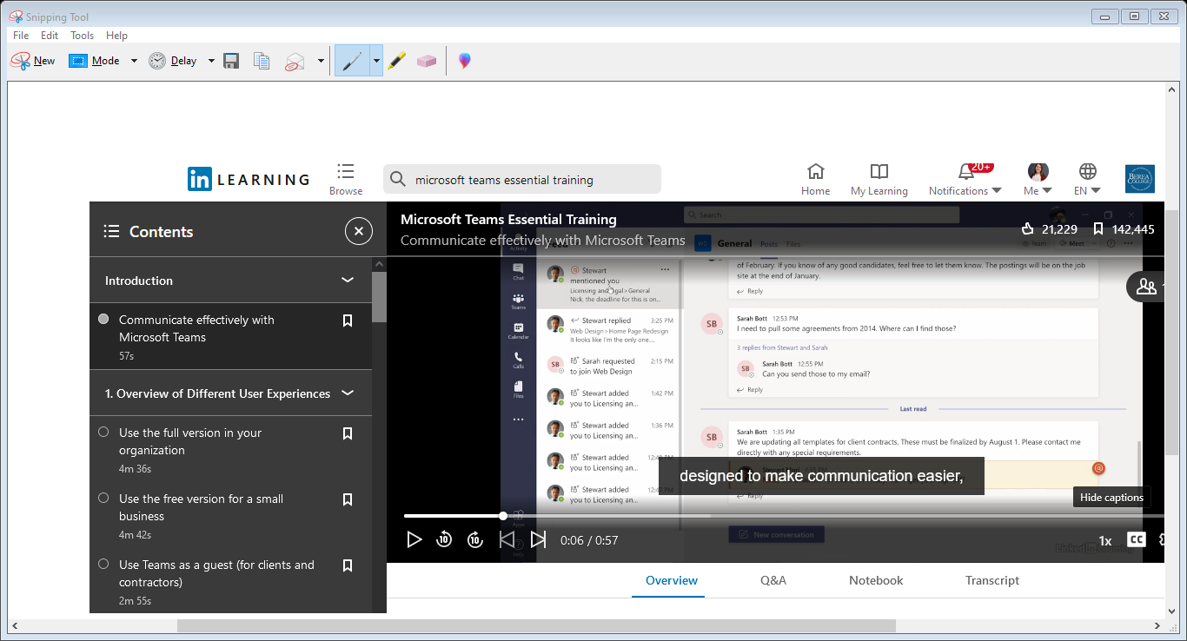
Notes:
To ensure everyone participating in these programs has training resources available we’ve created a training and development checklist and their associated resources.

Slide 12
Quarterly Check-In
Conversation for coaching, feedback, goal assessment
Long-Term schedules, strongly encouraged
Training in Cornerstone (Homepage, “My Training”)
Notes:
Check-in to see “is this working?” Employees and supervisors can talk through what can be improved and celebrate accomplishments.

Slide 13
Quarterly Check-In
Roll up to annual performance evaluation
Include up to 3 documents in annual eval
Date goals for evaluation year to include in annual eval
Notes:
Staff are asking for opportunities for more conversations.

Slide 14
What is next?
HR will publish policies and procedures to the campus, February 2nd via email
Including survey for feedback/questions
Q&A to come
Website with available resources and application, February 11th
Supervisors meet with their teams to summarize their department's plan
Review plan with AC member
Notes:
Agenda items/topics

Slide 15
Questions

