Slide 1

Notes:
Kelli

Slide 2
Knox Promise Neighborhood
Year 3 in Review
Calendar Year 2019
Notes:
Kelli—of course, you probably know me well enough to know I'm not just going to give you the information. You're going to have to guess. So, related to our overall spending in year 2, do you think we earned a green light—which meant we hit our target of spending for year 2 as a whole or did we earn a yellow light or a red light?

Slide 3

Did not meet target; did not progress
Notes:
Numerous people have contributed to gather and report information for today's State of the PN report to you. The program managers will be reporting primarily on programming and performance measures for their part of the pipeline. I, on the other hand, will be reporting on our indicators—the 21 indicators we report to the federal government that provide a picture of how well we are doing what we said we would do. Are we making a difference in our schools and communities? So throughout the day, my part of the presentation is interspersed. For example, after Tennant reports on her part of the pipeline, you'll hear me talk about the data and indicators that relate to the early childhood work. I'll be using these symbols. Red light means we did not show improvement and we did not meet our target. Explain targets change yearly.

Slide 4

Made progress; did not meet target
Notes:
Yellow means we did show improvement, but we did not meet our target.

Slide 5

Met target; made progress
Notes:
And green means we showed improvement and we did meet our target.
So why is this important? The most important reason is that we signed up to make a difference. We were given $30 million to make a difference, and everyone in this room has signed up for that and cares about their community.
The second reason is that we have a legacy to uphold. Berea PFE is well-known in the grant world. We are the achievers; we are the program that most others look to for success. We certainly want to continue that legacy of success.
The last reason is this: there are opportunities for extended funding past the original five years of our grant. But those opportunities are competitive. The biggest part of that competition is showing that we made progress and that we hit our targets in the first five years. Without that proof of success, it is highly unlikely that we will get the additional funding to extend our grant an extra two—possibly three—years.
So let's get started.

Slide 6
Overview of Spending
Notes:
Kelli—of course, you probably know me well enough to know I'm not just going to give you the information. You're going to have to guess. So, related to our overall spending in year 2, do you think we earned a green light—which meant we hit our target of spending for year 2 as a whole or did we earn a yellow light or a red light?

Slide 7
Exceeded Target

Slide 8
Notes:
We spent 97% of our budget it year 3. Finance set a goal of 95% for grant spending, so we surpassed that goal. I will tell you that more than half of our budget goes to salaries each year.
Toward the end of the year, we were taking a hard look at work plan budgets and realized that all three districts were underspent. So, we allocated about $80,000 to the districts for a technology purchase in November. That, along with many other activities throughout the year, enabled us to hit the 97% mark; however, that also limits the amount of carryover funds that will be allocated to work plans for this year because we have less carryover.
I hope we aren’t in a position to have to do that again because I will always choose experiences for children over technology for children.

Slide 9
Notes:
Would like to spend less than this in order to keep school-based staff in the school the entire school year of 2021-2022.

Slide 10
K-12 Program Managers

Slide 11
Internet Access
GPRA 15:
Number and percent of students who have school AND home access to broadband internet and a connected computer device.
Notes:
VOTE

Slide 12
Decrease; target not met
Internet Access
2018 actual:
96.9 (-1% change)
2019 actual:
92.5% (-4.5)
2019 target:
98.5%
2020 target:
98.7%
Notes:
This data is obtained from the school climate survey which is administered every fall in grades 7-12. With this particular measure, I think it is important to know that this is self-reported by students, and their perceptions might not reflect reality. We spent hundreds of thousands of dollars in technology for our school, and students reported a decrease in access. I believe that might be in part related to the fact that one entire district and another high school have banned personal devices during school hours. So this decrease in access might be related to how students feel about immediate access in their pockets versus their access to equipment and internet in the actual school building.

Slide 13
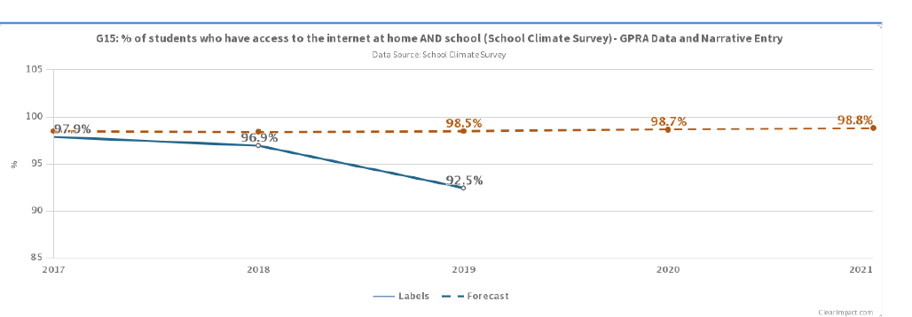
Visually…

Slide 14
Academics
GPRA 4A
Number and percent of students at or above grade level according to state math and English language arts assessments in at least the grades required by the ESEA (3rd-8th and once in high school)
Notes:
VOTE

Slide 15
Increase; almost met target
ELA Scores
2018 actual:
56.3 (0% change)
2019 actual:
59.6% (up 3.3)
2019 target:
60.4%
2020 target:
61.4%
Notes:
Overall, we saw the biggest gains in reading at the 4th-grade level 8th-grade level—both with double digit gains. The largest decreases in reading were at the High school and 3rd-grade level.
Do a little math with me. Write down the number of students you have that take a reading KPREP test. In high school, it would be about the size of your junior class. In the elementaries/middles, it would be grades 3-8.
Now, look at the difference in our 2019 target and our 2018 actual. 4.1%. now multiple .041 times the number of students. That's the number of students that need to be moved to proficiency in reading in your school this year for us to reach our target.

Slide 16
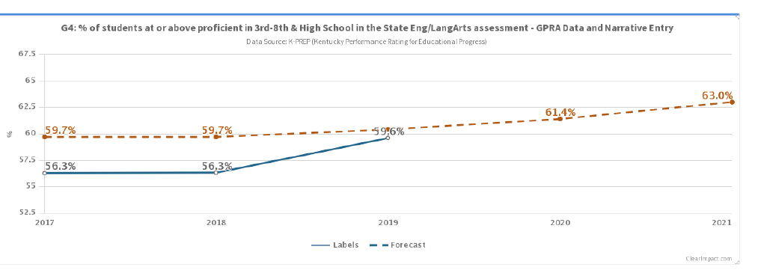
Visually…

Slide 17
Graduation
GPRA 6
Students graduating high school in four years.
Notes:
VOTE

Slide 18
Increase; target not met
Graduation
2018 actual:
92.8 (-2% change)
2019 actual:
93.4% (up 0.6)
2019 target:
96.7%
2020 target:
96.8%
Notes:
We saw the largest decrease in graduation at Lynn Camp and Knox Central. Lynn Camp had a decrease of 4%; Knox Central of 2%. Barbourville and Corbin remained essentially the same at their high schools; however, it is important to note that we calculate graduation rate on the district numbers—not the individual high schools. So, Corbin as a district, for example, saw a decrease once the SOI and CEC were factored in.

Slide 19
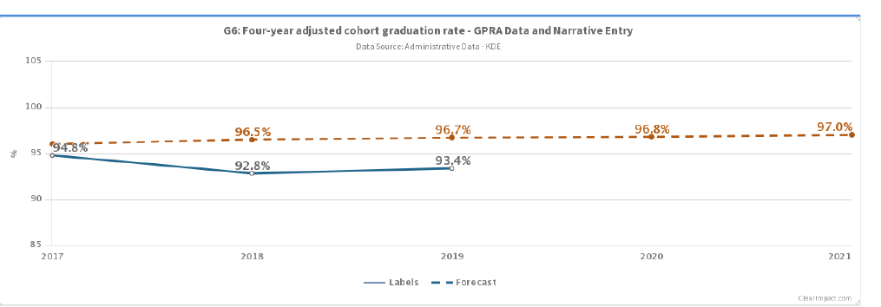
Visually…

Slide 20
Knox County
Curriculum/PD
2020-2021
Years 1, 2 and 3
  375 teachers trained in Kagan Strategies (days 1-4)
    in-class coaching provided
  Thirty new teachers trained in Kagan Strategies (days 1-2)
Year 4 Goal
  New teachers (30) trained in days three & four
  New teachers (30) to receive coaching
  District (400) teachers trained in day 5
    Coaching for all teachers on day 5 strategies
Year 5 Goal
  All Teachers trained in Kagan Strategies (days 1-5)
  All teachers received in-class coaching for all days
  A Kagan Coach in all schools

Slide 21
Barbourville Independent
Curriculum/PD
2019-2021
Years 1, 2, and 3
Years 4 and 5
Curiosity Corner (Preschool-Reading)
2 teachers-100% classroom implementation
Reading Edge (6th grade-8th grade reading)
6 teachers-100% classroom implementation
Envision Math (K-6th grade)
14 teachers-100% classroom implementation
Kagan Strategies (K-12) District wide trainings, classroom observations, and coaching strategies.
To ensure fidelity of the curriculum purchased, yearly PD sessions are scheduled. These sessions provide a review for teachers who have used the program and introduce new teachers to the curriculum and its intended use.
Fully staffed, and successfully working with teachers and staff.
All teachers using curriculum with fidelity.
Provide additional PD sessions requested by teachers.
Maker’s Spaces and STEAM labs usage has increased.
Trauma Informed Care PD for teachers and staff
Ms. Kendra curriculum (elem.)
Student Leadership teams—successful

Slide 22
Corbin Independent Schools
GPRA 4A and 4B; GPRA 6
Year 3:
  Continued Implementation of Eureka Math in K – 4 from beginning of year
  Added Zearn online platform in collaboration with Eureka Math
  Continued AP incentives and ELA NMSI summer cohort (year 2 of 3)
Year 4:
  Thorough study and review for new ELA curriculum with Fall 2020 target for implementation
  Emphasis on vertical alignment in district including professional development
  Continue AP incentives and ELA NMSI summer cohort (year 3 of 3)
GPRA 15 – Recent tablet ‘check-out’ at schools (?)

Slide 23
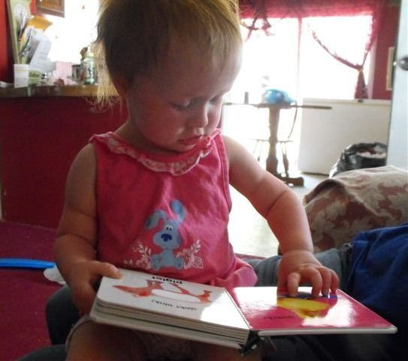
Early Childhood

Slide 24
Early Childhood GPRA 1
Number and percent of children birth to five years old who have a place where they usually go, other than an emergency room, when they are sick or in need of advice about their health (medical home).
Notes:
VOTE
Kelli's slide

Slide 25
Decrease; target not met
2017actual:
86.9%
2019 Actual:
83.7%
2019 target: 92.7%
2020 target: 93.6%
Notes:
This information is obtained through the Neighborhood Survey every other year. Year 2 was not a survey year; however Year 3 will be. Allow me to prepare you for that. In year 2, we distributed the Neighborhood Survey through our school districts. Most of you were no onboard yet when that happened. It does require a lot of work on the ground to get the surveys home to all of our student families and get them completed. You will be getting instructions over the summer on how to do this. We had completion rate of about 44% the first year—which was pretty good considering we also had demographic information to college, which made the survey several pages long. This year's will be shorter, but it still will take a lot of work for our school-based staff to promote the survey and make sure we get the survey back.

Slide 26
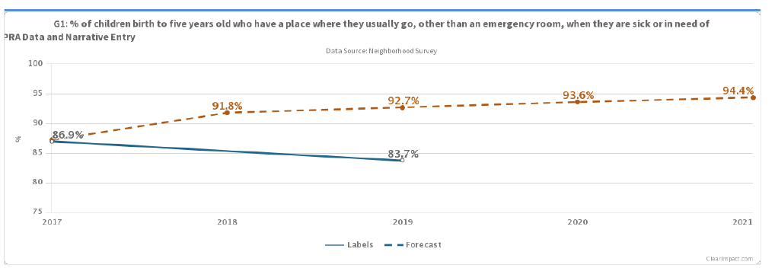
Visually…

Slide 27
Early Childhood GPRA 1
Story Behind the Curve
Response rate for 2019 was nearly
20 points higher than 2017
– possibly more educated
2017 enrollment showed >10%
with Masters degree; Census
showed <10% with Bachelors
Strategy
SAVE the Children
  ESSS (422 families)
  Playgroups (445 families)
Knox PN
  Promotes the definition of school readiness in Kentucky, defined by the Governor’s Office of Early Childhood
  Provides experiences that include a focus on health and physical well-being for both children and families.
Notes:
VOTE

Slide 28
Early Childhood GPRA 2A
Number and percent of 3-year olds and children in kindergarten who demonstrate at the beginning of the program or school year age-appropriate functioning across multiple domains of early learning (GPRA 2A and 2B)
Notes:
VOTE

Slide 29
Stayed same; target met
3-year-old
2018 actual:
87.0% (up 12%)
2019 actual:
86.8%
2019 target:
85.5%
2020 target:
92.2%

Slide 30
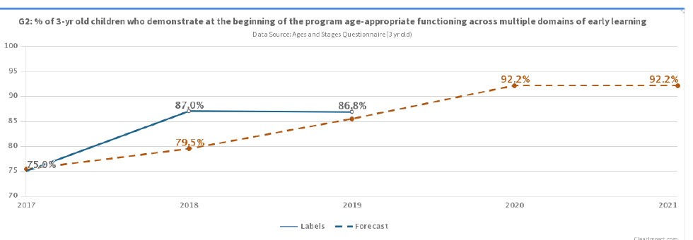
Visually…

Slide 31
Early Childhood GPRA 2A
Story Behind the Curve
Slight decrease in the number of three-year-old children showing age-appropriate development (0.2 percentage point decrease)
An increase in the number of children meeting kindergarten readiness standards (2.5 percentage point increase).
Both data points are at or above our targets.
Strategy
Minimal 3 yr. olds are enrolled in early care and education centers (child care) that conduct screenings
Using DPIL database to find families
  fall of 2018 - 54 three year olds screened with ASQ.
  87% of these children demonstrated age appropriate
  Fall of 2019 - 42 three year olds screened with ASQ
  85.7% of these children demonstrated age-appropriate
Challenge connecting with families
Help Me Grow online community wide screener
Notes:
VOTE

Slide 32
Early Childhood GPRA 2B
Number and percent of 3-year olds and children in kindergarten who demonstrate at the beginning of the program or school year age-appropriate functioning across multiple domains of early learning (GPRA 2A and 2B)
Notes:
VOTE

Slide 33
Increase; almost met target
K- Readiness
2018 actual:
42.7% (up 7.6)
2019 Actual:
45.2% (up 2.5)
2019 target:
45.6%
2020 target:
47.2%

Slide 34
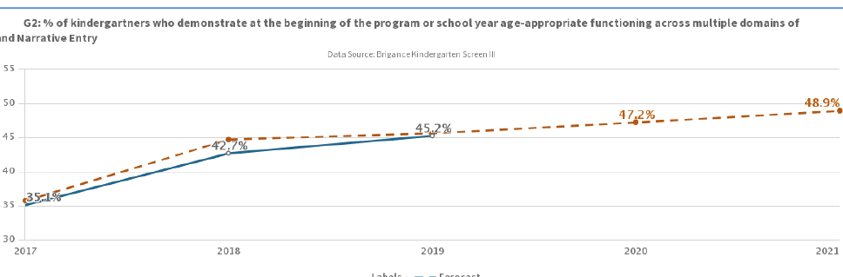
Visually…

Slide 35
Early Childhood GPRA 2B
Story Behind the Curve
Slight decrease in the number of three-year-old children showing age-appropriate development (0.2 percentage point decrease)
An increase in the number of children meeting kindergarten readiness standards (2.5 percentage point increase).
Both data points are at or above our targets.
Strategy
Fall 2019
  504 children were assessed
    Of those children, 228 or 45.2% demonstrated age appropriate; an increase of 2.5 percentage points from 42.7 percent in 2018.
  DPIL
    1466 children served/11,176 books
  SAVE the Children
    KinderBoost (105)
    ESSS (422), PLG (445), backpack program (249).
    VROOM
  Coaching and curriculum supports
  KY ALLStars
    4 centers – 2/2
  Community Awareness
    Community collaborative
    WOYC
    Partnerships
  Professional Development
    53 teachers/835 children
    Residencies – 6 centers/225 children
Notes:
VOTE

Slide 36
Early Childhood GPRA 3
Number and percent of children 0-5 attending center-based AND home-based care.
Notes:
VOTE

Slide 37
Increase; met target
2017 actual:
53.1%
2019 actual:
75.3%
2019 target: 57.2%
2020 target: 57.7%

Slide 38
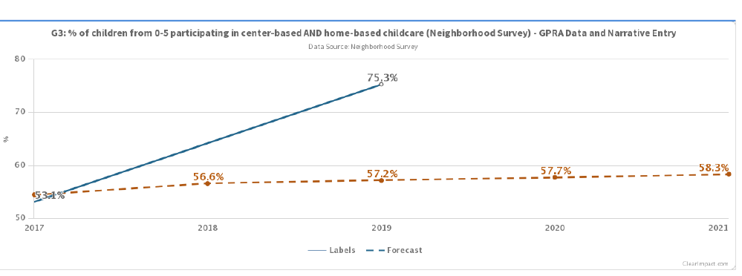
Visually…

Slide 39
Early Childhood GPRA 3
Story Behind the Curve
2017 Neighborhood Survey
  53.1%of families participating;
2019 Neighborhood Survey -
  75.3% participating (157 more children enrolled in center-based or home-based childcare)
Families are more aware
High quality centers – KY ALLStars
Strategy
KY-ALLStars
Awareness in communities
Toolkits
Arts Integration
We are not sure how our larger sample size played into this particular indicator.
Notes:
VOTE

Slide 40
Early Childhood GPRA 12
Number and percent of parents or family members who report reading to their children three or more times per week.
Notes:
VOTE

Slide 41
Stagnant; did not met target
2017 actual:
58.5%
2019 actual:
58.3%
2019 target: 64.7%
2020 target: 65.4%
Notes:
This information is obtained through the Neighborhood Survey every other year. Year 2 was not a survey year; however Year 3 will be.

Slide 42
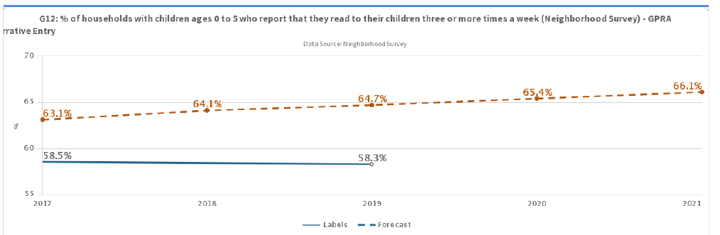
Visually…

Slide 43
Early Childhood GPRA 12
Story Behind the Curve
2017 - 58.5% report reading to their children three or more times weekly
2019 - 58.3% slight decrease (0.02 percentage points)
2019 Neighborhood Survey response rate - nearly 20 percentage points higher than it was in 2017 (more than 1,400 additional survey completions).
Strategy
Increased enrollment in Save programs
Ongoing Professional Development
  Many specific to literacy
Union and PFS partnership
Strengthening Families Framework embedded into programing
DPIL and SignalVine
WOYC
KPN = Many resources on reading to their children.
Notes:
VOTE

Slide 44
Family Engagement

Slide 45
Student Mobility
GPRA 11:
Student mobility rate: the number of student entries and withdrawals from the first day of official enrollment.
Notes:
VOTE

Slide 46
Decrease and target met
Mobility
2018 actual:
9.6% (-10.1)
2019 actual:
8.2% (-1.4)
2019 target:
18.9%
2020 target:
18.8%
Additional info.: 2017 mobility rate: 19.7%.
Notes:
This measure is pulled directly from IC and will change by the end of the school year. A decrease is considered positive in this measure because it means more students are staying in their schools longer and not transferring from school to school, which interrupts the learning process. The largest decrease is attributed to Corbin Ind., which traditional has had the highest mobility rate. Barbourville and Knox County each had a slight drop—more in line with what we had expected.
Even though we expect the year-end mobility numbers to be higher than 9.6, we still are considerably lower this year than we were at this time last year.

Slide 47
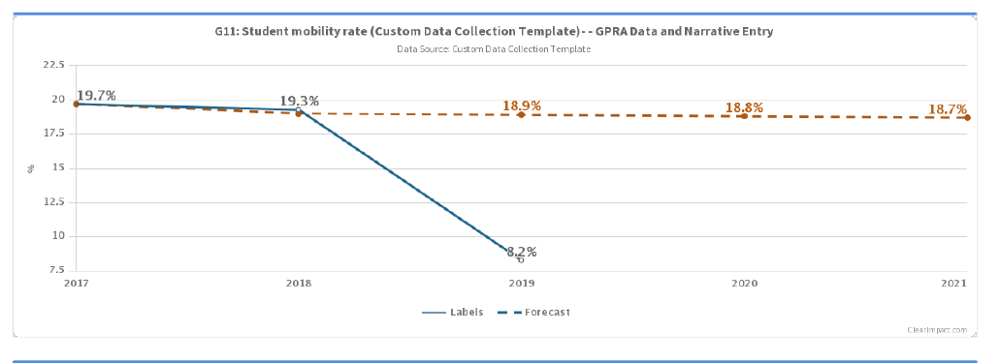
Visually…

Slide 48
K-8 Literacy
GPRA 13
For children in kindergarten through 8th grades, the number and percent of parents or family members who report encouraging their children to read books outside of school.
Notes:
VOTE

Slide 49
Decrease; target not met
2017 actual:
72.1%
2019 actual:
59.4% (-12.6)
2019 target: 73.9%
2020 target: 74.1%

Slide 50
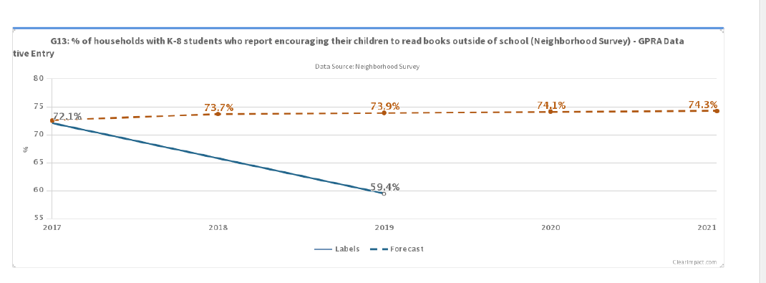
Visually…

Slide 51
Talking about College & Career
GPRA 14
For children in the 9th-12th grades, the number and percent of parents or family members who report talking with their child about the important of college and career (last 6 months)
Notes:
VOTE

Slide 52
Decrease; target not met
2017 actual:
83.9%
2019 actual:
81.3% (-2.6)
2019 target:
87.3%
2020 target:
88%
Notes:
This information is obtained through the Neighborhood Survey every other year. Year 2 was not a survey year; however Year 3 will be.

Slide 53
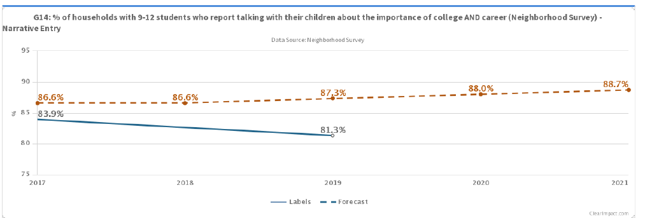
Visually…

Slide 54
Family Engagement Programs
2019-2020
FAST (GPRA 11, 13, 14)
Parenting for Success (GPRA 11, 13 14)
All Pro Dads (GPRA 11, 13, 14)
Book Clubs (In Person & Virtual) (GPRA 11,13)
Academic Interventionist Monthly contacts (GPRA 11,13,14)
Family College Visits (GPRA 11, 14)
myOn Family Literacy Academy (GPRA 11,13)
Family Reading/Math/STEAM nights (GPRA 11,13, 14)
FAFSA/KHEAA parent nights (GPRA 11,14)
Transition Workshops ( GPRA 11, 13, 14)
Partnerships with PN school coordinators, AI’s, schools (FRYSC & teachers), and community partners

Slide 55
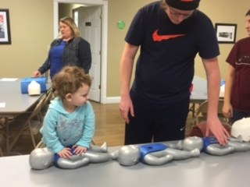
Parenting for Success
Building social capital for parents & children
Receive social & emotional support
Linkage to community resources
Support to become effective parents & successful adults
Knowledge of the importance of early literacy skills
Increased sense of empowerment
Gain a feeling of belonging
Reduces student mobility
Learn age-appropriate development of their children
Benefits of crafting together:
  Breaks down barriers
  Improves skills and knowledge
  Reduces stress
  Increases self-esteem
  Increases the ability to express self

Slide 56
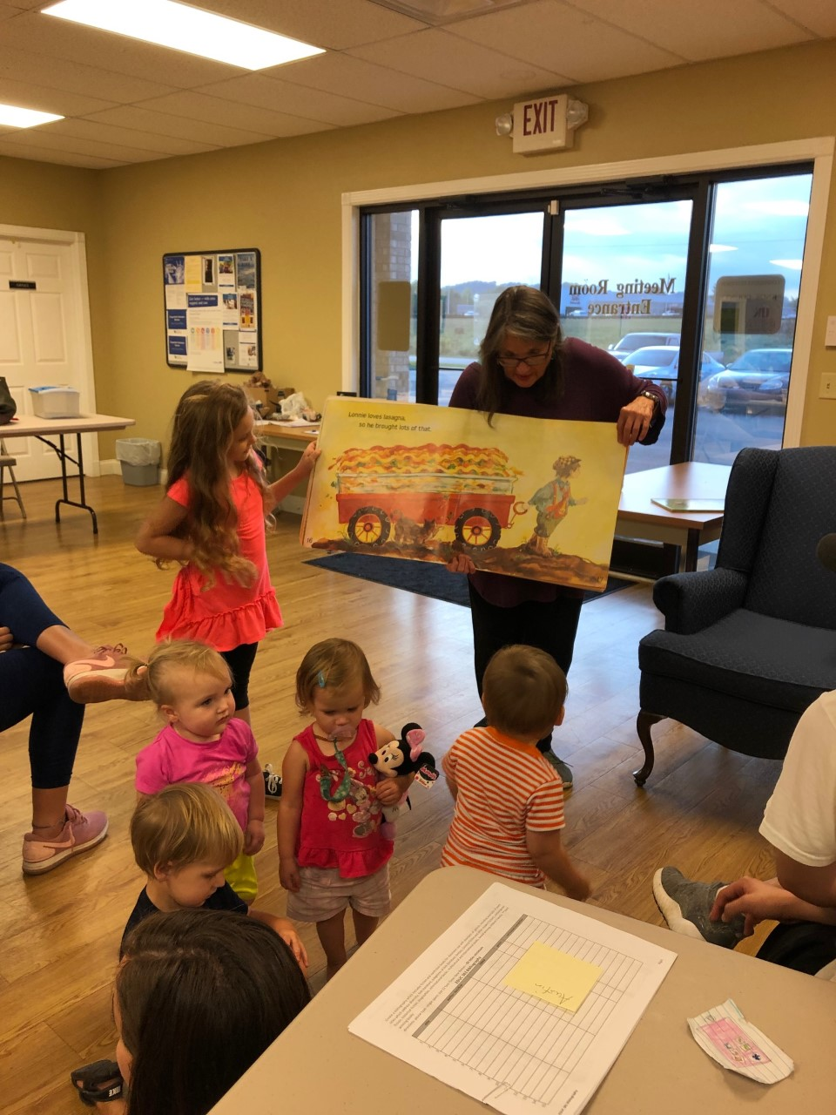
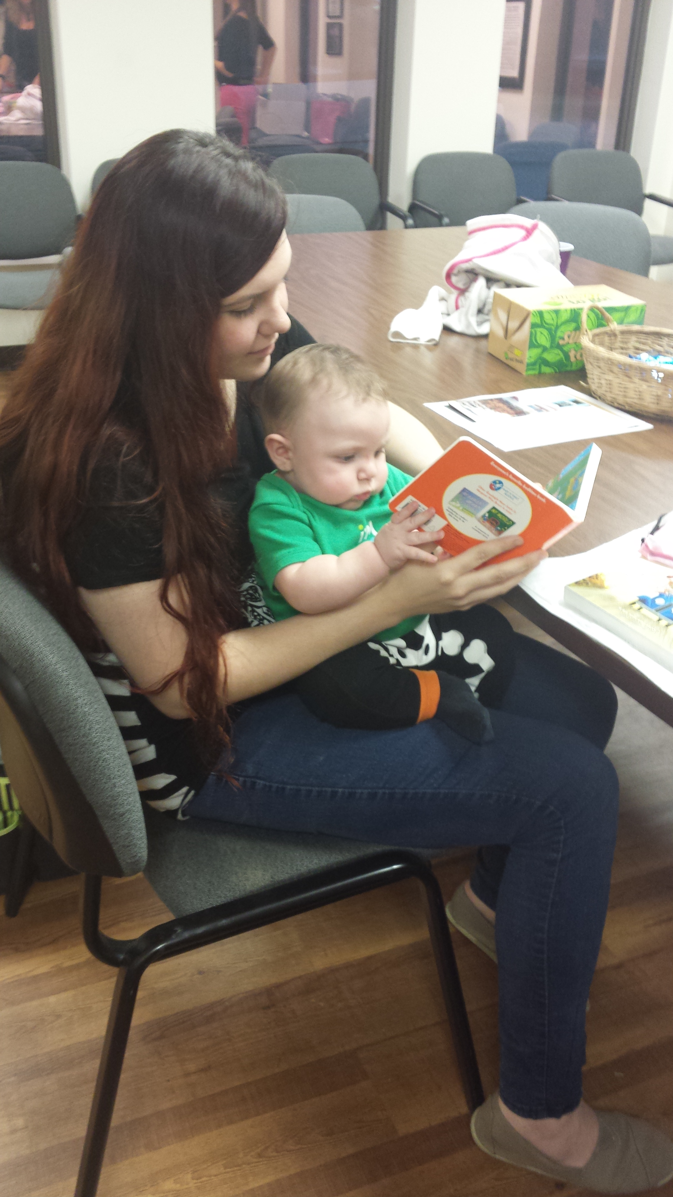

Slide 57
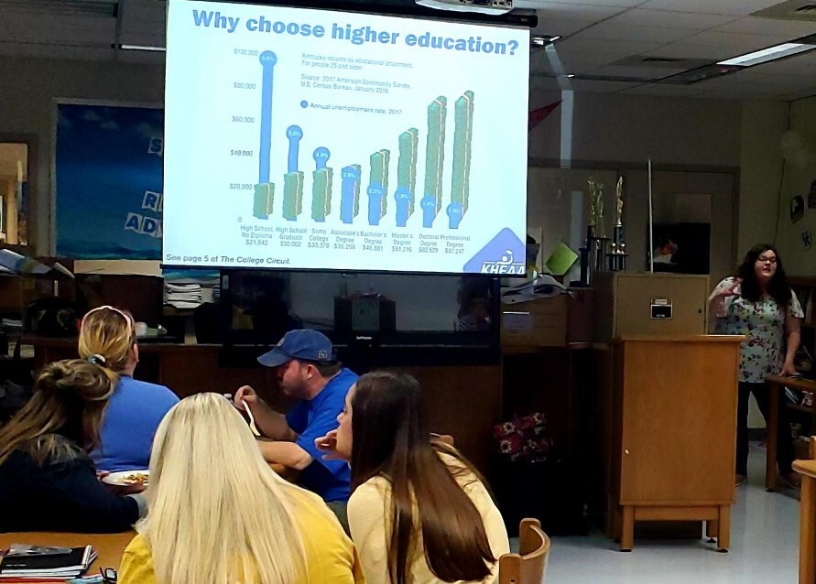
College/Career

Slide 58




Freshman Orientation
Earning KEES money, day one.
Dual Credit opportunities.
ACT importance.
Family College Visits
Middle school and high school
partnerships with gear up
partnerships between districts
Mailing Literature Home
KEES Money Information
KHEAA Resources
ACT Guide
ACT Dates
FAFSA Nights
Partnerships with KHEAA
Partnerships with Gear Up
KEES Nights
Scholarship Nights

Slide 59
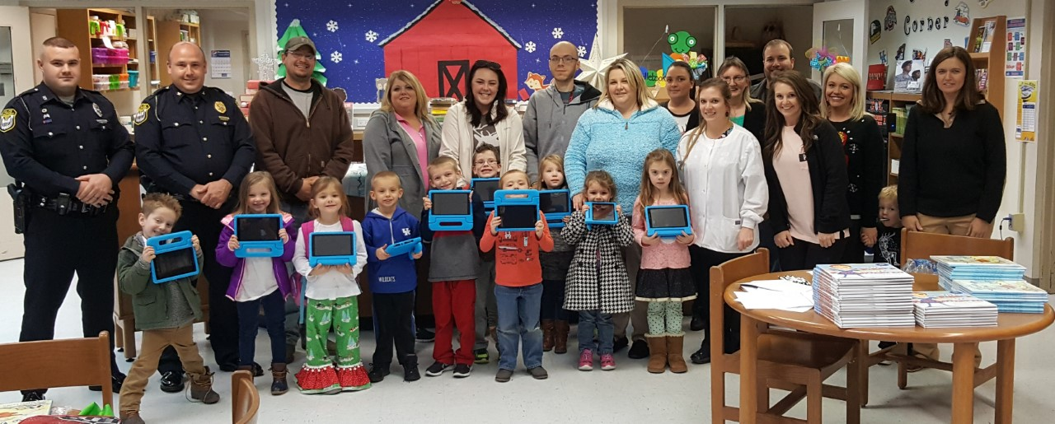
myOn
Family Learning Academies
Traditionally using myOn
Offering to targeted grades
Offering to entire schools
Reading Pledges
Providing devices
Providing physical books
Three sessions:
1. Introduction To myOn
2. Internet Safety
- with Kayla Hubbard
3. Final Session- get device

Slide 60
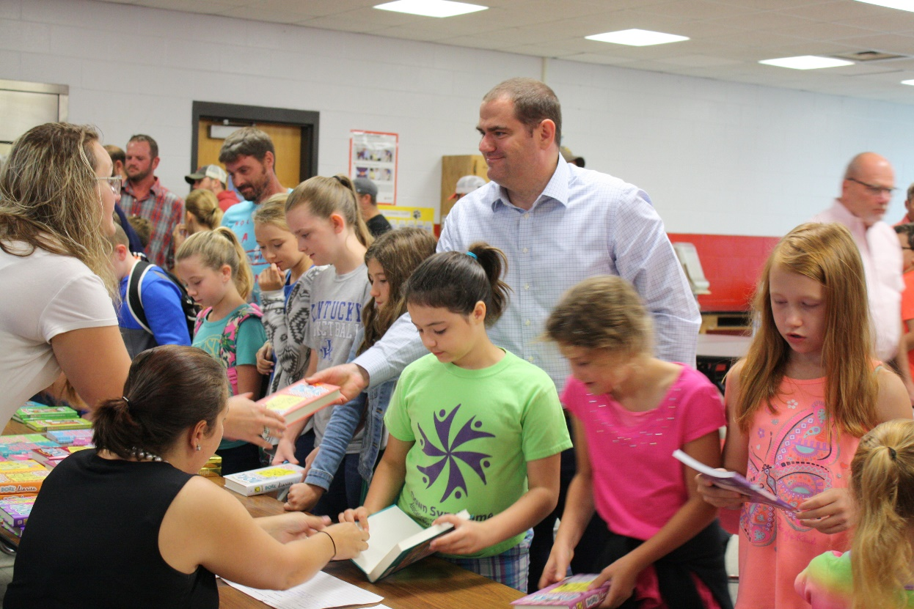
All Pro Dad- Breakfast
Objectives:
Provide opportunity for dads to spend quality time with their child(ren).
Strengthen the father/father figure’s relationship with their child(ren).
Allow father/father figure to feel comfortable with communicating with at least one person in their child(ren)’s school.
For children in K–8th grades, the number and percentage of parents or family members who report encouraging their children to read books outside of school.
APD meets four times per school year. Fathers/father figures (neighbors, older siblings, uncles, grandfathers, etc.) were invited to attend with students in targeted grades. Families would be served a meal, curriculum provided by the APD program would be lead by a male facilitator from the school, and a drawing for door prizes donated by the YSC would occur at each meeting. Following the conclusion of the program Fathers/Father figures were invited to pick a book out together to take home and read together.

Slide 61
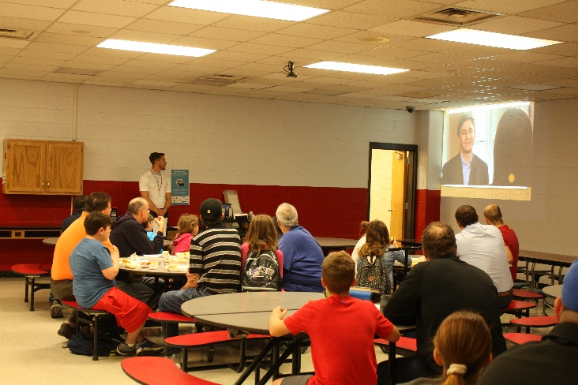
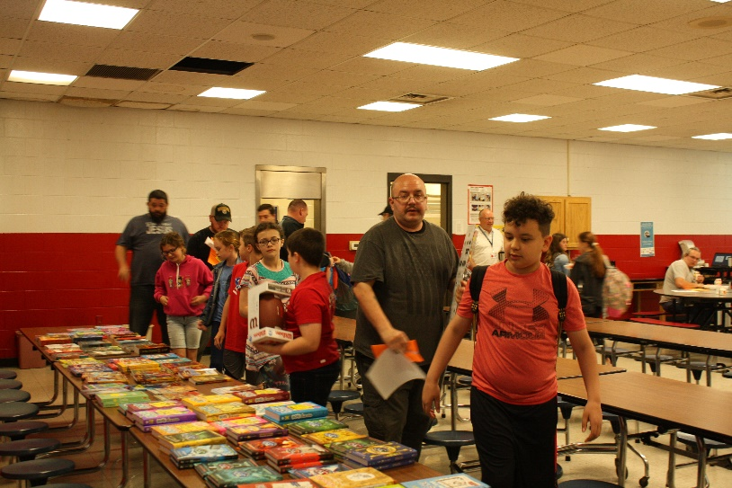
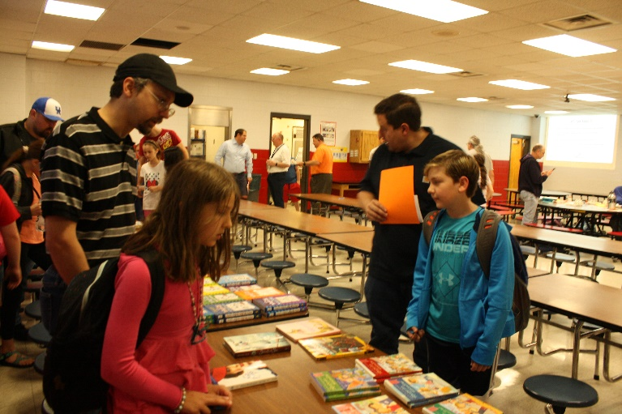
Survey Says…
50% of the father/father figures who attended more than one All Pro Dad Breakfast said that they used the book that they received at the APD Breakfast to read with their child at home.
When asked “What do you like most about the APD Breakfast?”
Spending time with my kid
Get to hang out
Time with (child’s name)
Nice to see the school and be alone with my daughter
Food
The staff who run the program show a real interest in the program. Would not change anything. This is a great program!
Time together
Collegial atmosphere/meeting other dads
Special time with just my daughter
Both my kids love the APD. It makes them feel special.
A quiet time when I can focus entirely on her.
Community. One-on-one with child. The messages given.
Just getting to see (student’s name) at school and spend time with her.
Thanks for providing this opportunity for us to share and create memories with (student’s name)
Spending time together before the day starts

Slide 62
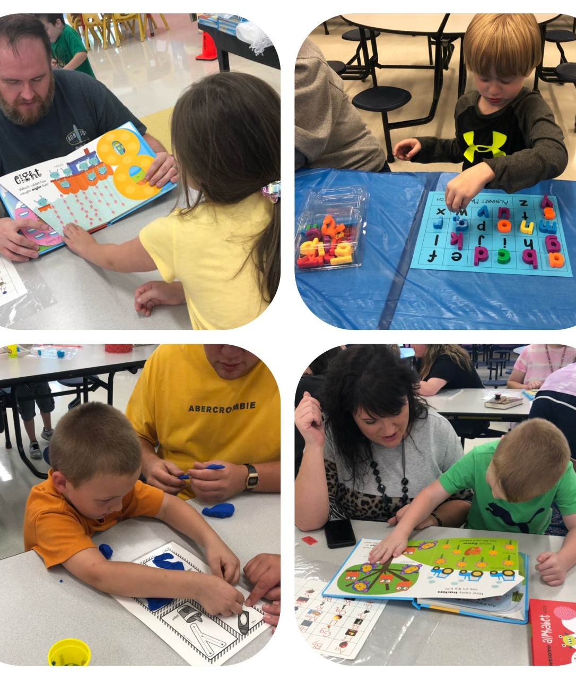
Families in the Know Workshop
GPRA 11- Student Mobility
GPRA 13- K-8 Literacy
Kindergarten students
2 Sessions (15 families attended)
Teachers demonstrate activities & strategies for parents to use at home to teach skills such as identifying letters & numbers, sight words and other beginning reader activities.
Families receive supplies/materials to enforce learning at home

Slide 63
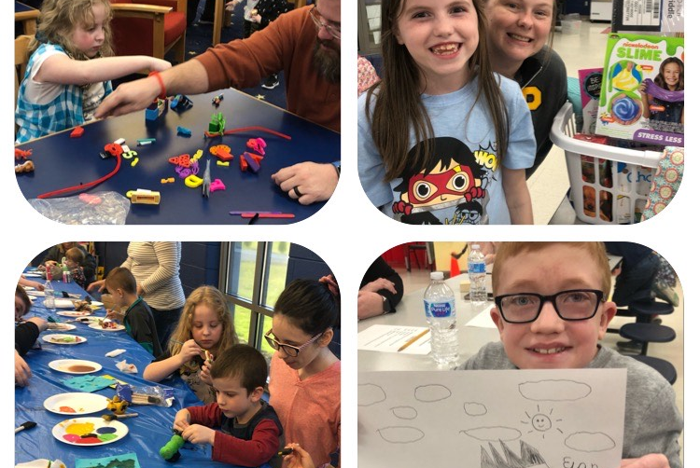
FAST Elementary
GPRA 11- Student Mobility
GPRA 13- K-8 Literacy
Components of Elementary
FAST
Family Meal
Scribbles
Feelings Charades
Kid Time
Parent Group
1:1 Time
Gift Basket
8 week cycle
2.5 hour sessions
Families must attend at least 6 session to graduate

Slide 64
FAST
Research shows that FAST…
Empowers parents as leaders of their families
Builds positive connections and social capital between families and schools
Creates a supportive community engaged in fostering children’s well-being and education.
During FAST, families have an opportunity to spend time together, eat a meal, play games, and get to know other families.
80% of families who attend one FAST Session will successfully complete the program – one of the highest retention rates among parent empowerment programs.
In 2017 two cycles were completed;
2018 five cycles; and
2019 four cycles.

Slide 65

Prime Time Reading
This program was grant funded by the Kentucky arts and Humanities council for a 6 week program.
We partnered with many others as well, UK, and team members from EKU.
The grant was applied for twice and awarded on the second try.
The purpose was to promote reading at home with focu on developing critical thinking skills.

Slide 66

Big Picture
The evening:
Families were welcomed at the door by a team member and were directed to the cafeteria for a family dinner.
After dinner the story-teller read the books of the week with an engaging and enthusiastic tone.
After each book the scholar asks critical thinking questions, for example, after The True Story of the Three Little Pigs: “Have you ever felt like someone was not being honest? If so how did you feel? What did you do?”

Slide 67
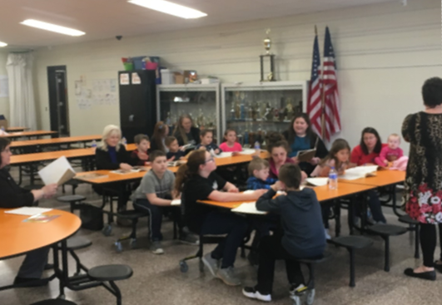
Story Time
Each participating family has a copy of the book so they can follow/read along with the story teller. This program was so popular that students approached the Family Engagement Coordinator to get books for the event they missed so they would not be behind when participating in the next event.

Slide 68
High School FAST
Teen night- Knox Central High School

Slide 69
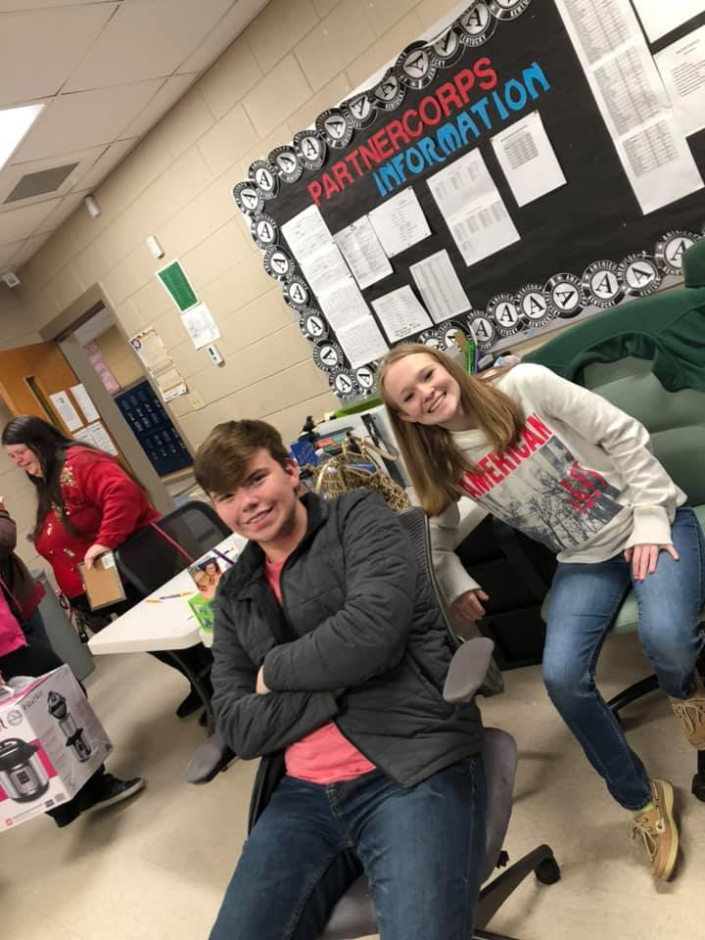
FAST Overview
FAST Team: Site Coordinator, school partner, parent partner, youth partners, and community partner.
Special week 5
Graduation Week 8
FAST WORKS after the cycle
The parent partner receives a stipend for their role on the team. The youth partners are awarded $500 in technology for their work.
FAST is an 8 week program that seeks to empower parents and strengthen the family unit by establishing open lines of communication.

Slide 70

Family Meal
As FAST Families arrive they are greeted by a member of the team.
The night begins with a family meal.
During the meal, as with the rest of the night, the use of cell phones is discouraged.
The parents are notified when the meal is ready and then they are asked to bring their family to make plates.
All discussion stays at the families table. No talking to other families.

Slide 71
Ice Breaker
One of the tasks of the youth partners is to come up with and lead an Ice Breaker at every meeting.
This helps create community among families that may or may not know each other outside of FAST.
It also helps to make everyone feel a bit more comfortable.

Slide 72
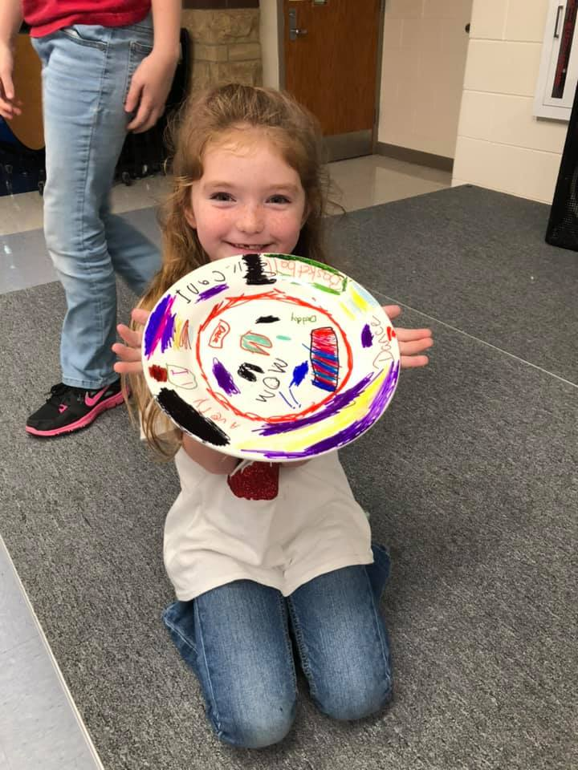
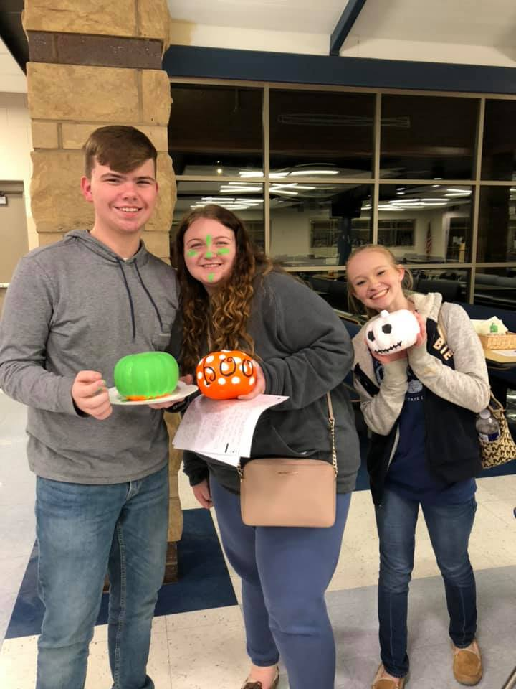
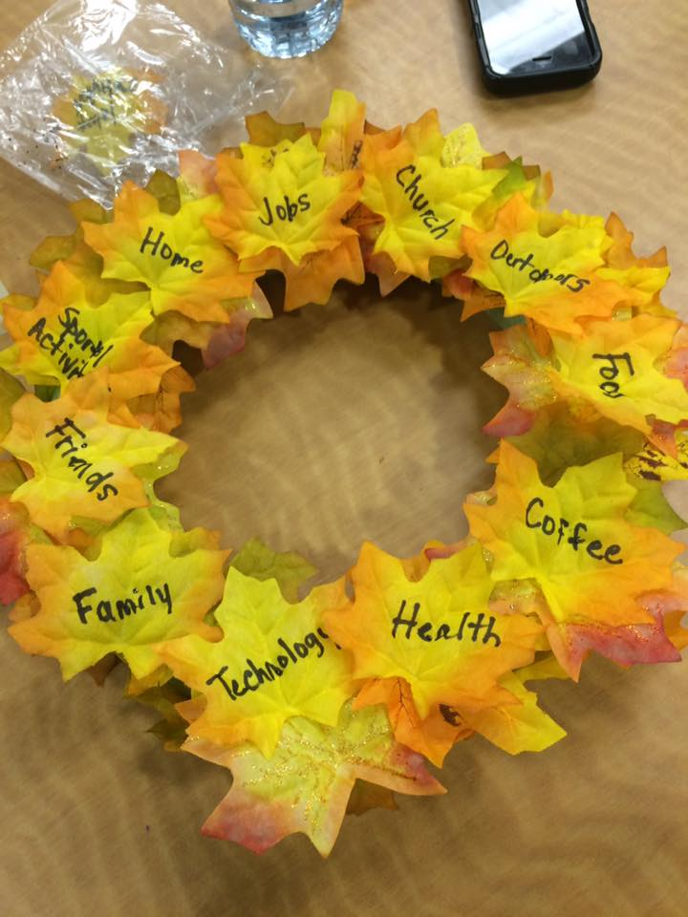
Family Project
Another task of the youth partners
Families work on a different craft each night
All ages enjoy this part (yes, even the teens who are generally too cool for this sort of thing)
Crafts may focus on seasonal items or themes that focus on the family. So many options!

Slide 73

Buddy Time/Parent Group
Buddy Time- 2 parents paired up to talk and actively listen for 7.5 minutes each
Parent Group- Parents get the opportunity to talk to each other about whatever they would like.
It is amazing to see parents that may not otherwise ever talk to each other, connect and develop a real friendship.

Slide 74

Youth Group
Teens also get a chance to talk amongst themselves, this is facilitated by the school partner.
During this time, teens come up with questions they would like to ask anonymously to their parent.
1:1 time follows during which the duos discuss the questions that were recorded, in a judgement free zone.

Slide 75
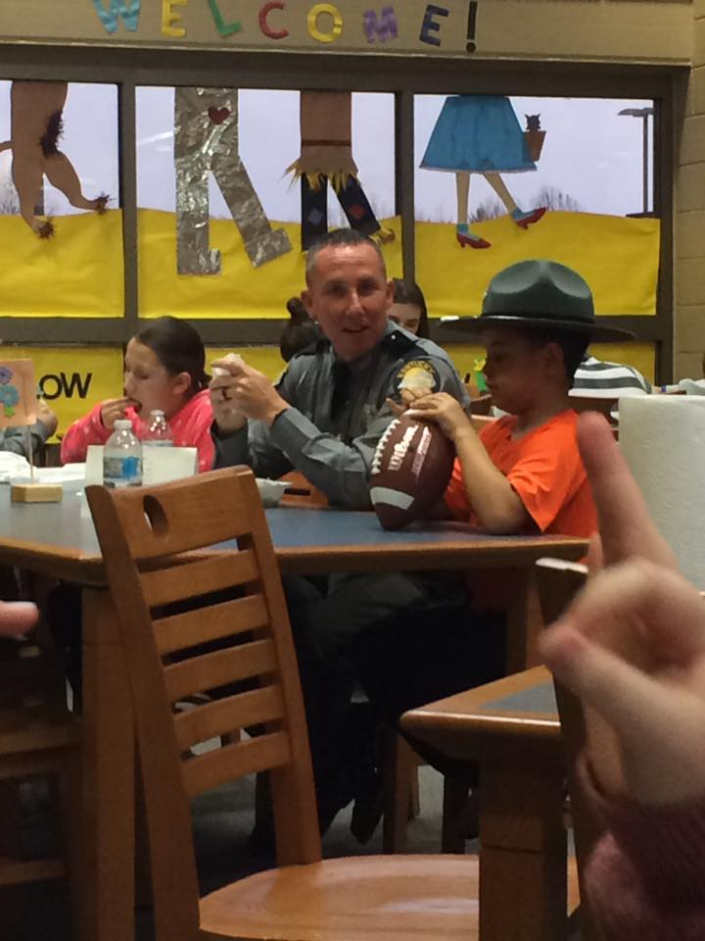
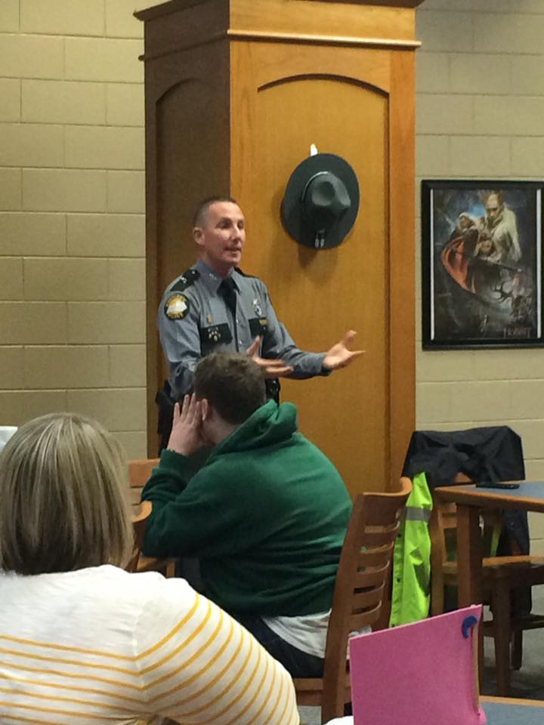
Week 5
Week 5 is guest speaker night, the topic is decided on by the participants.
Trooper Jacobs volunteered to speak on school safety from the KSP perspective.

Slide 76
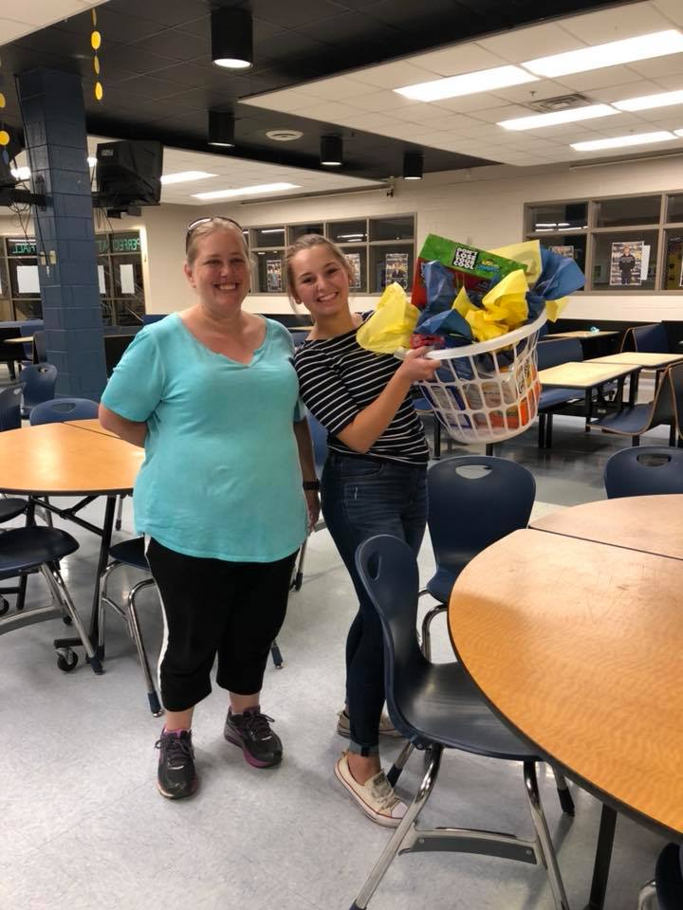
Other Elements
Mutual Affirmations
Family Lottery Basket
Closing announcements/RAIN
Lottery is fixed, everyone wins eventually, Baskets are themed with items that encourage family time.

Slide 77
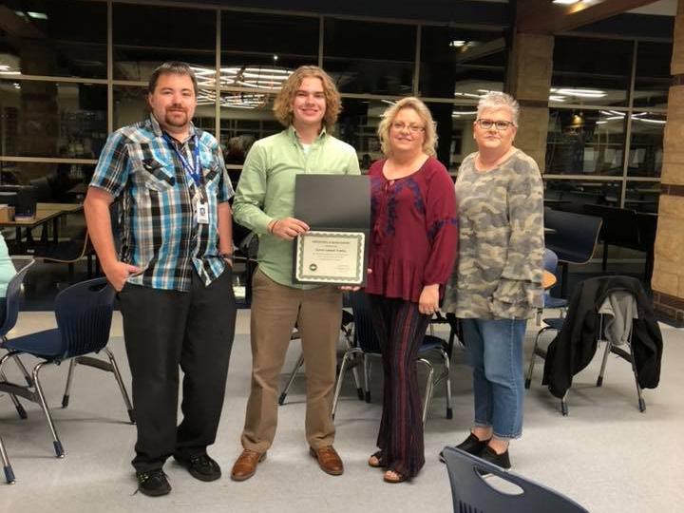
Graduation
Week 8, families who complete 6 of 8 sessions graduate from FAST. Each family gets a certificate to honor their accomplishment.

Slide 79
Academic Case Management
Notes:
Next up is Jenna Lawson who oversees our academic case management as our program manager for academic services.

Slide 80
Academics
GPRA 4B
Number and percent of students at or above grade level according to state math and English language arts assessments in at least the grades required by the ESEA (3rd-8th and once in high school)
Notes:
VOTE

Slide 81
Increase; target not met
Math Scores
2018 actual:
46.3 (-0.4% change)
2019 actual:
50.6% (up 4.3)
2019 target:
53.7%
2020 target:
54.7%
Notes:
Math saw the largest gains in 5th and 6th grade—double digit increases. We saw the largest drop in math proficiency from 2018 to 2018 in high school, with a 19 percent drop.
Do a little math with me. Write down the number of students you have that take a math KPREP test. In high school, it would be about the size of your junior class. In the elementaries/middles, it would be grades 3-8.
Now, look at the difference in our 2019 target and our 2018 actual. 7.3%. now multiple .073 times the number of students. That's the number of students that need to be moved to proficiency in math in your school this year for us to reach our target.

Slide 82
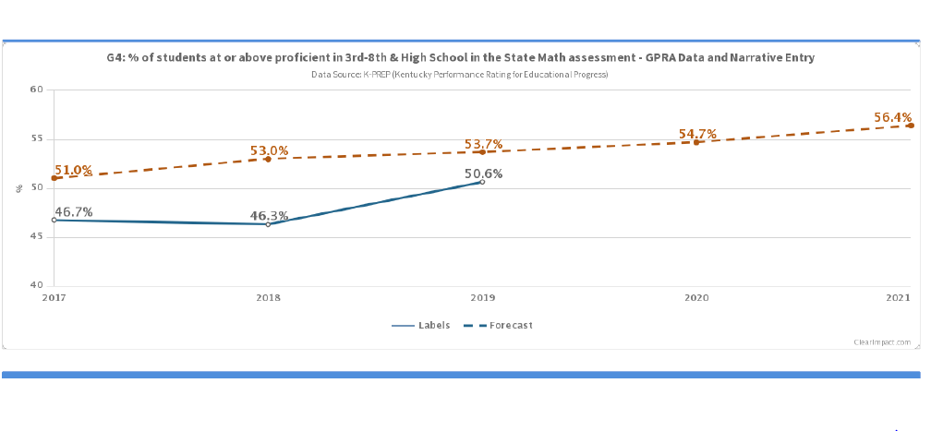
Visually…

Slide 83
Math
Source: “Assessment By Grade” data file for 3rd-8th grade proficiency calculations and the “ACT_CPE_Benchmarks” data file for the High School proficiency. Both files are located on new School Report Card Datasets webpage: https://openhouse.education.ky.gov/Home/SRCData

Slide 84
Knox Promise Neighborhood

Slide 85
Barbourville Independent School

Slide 86
Corbin Independent Schools

Slide 87
Knox County Public Schools

Slide 88
Knox Promise Neighborhood by School

Slide 89
Knox Promise Neighborhood by School

Slide 90
Academics
GPRA 4A
Number and percent of students at or above grade level according to state math and English language arts assessments in at least the grades required by the ESEA (3rd-8th and once in high school)
Notes:
VOTE

Slide 91
Increase; almost met target
ELA Scores
2018 actual:
56.3 (0% change)
2019 actual:
59.6% (up 3.3)
2019 target:
60.4%
2020 target:
61.4%
Notes:
Overall, we saw the biggest gains in reading at the 4th-grade level 8th-grade level—both with double digit gains. The largest decreases in reading were at the High school and 3rd-grade level.
Do a little math with me. Write down the number of students you have that take a reading KPREP test. In high school, it would be about the size of your junior class. In the elementaries/middles, it would be grades 3-8.
Now, look at the difference in our 2019 target and our 2018 actual. 4.1%. now multiple .041 times the number of students. That's the number of students that need to be moved to proficiency in reading in your school this year for us to reach our target.

Slide 92
Visually…

Slide 93
Reading
Source: “Assessment By Grade” data file for 3rd-8th grade proficiency calculations and the “ACT_CPE_Benchmarks” data file for the High School proficiency. Both files are located on new School Report Card Datasets webpage: https://openhouse.education.ky.gov/Home/SRCData

Slide 94
Knox Promise Neighborhood

Slide 95
Barbourville Independent School

Slide 96
Corbin Independent Schools

Slide 97
Knox County Public Schools

Slide 98
Knox Promise Neighborhood by School

Slide 99
Knox Promise Neighborhood by School

Slide 100
Caseload

Slide 101
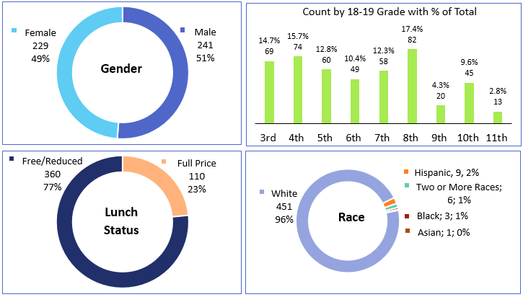

Slide 102
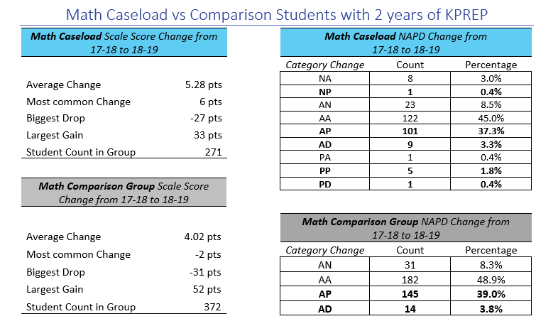

Slide 103
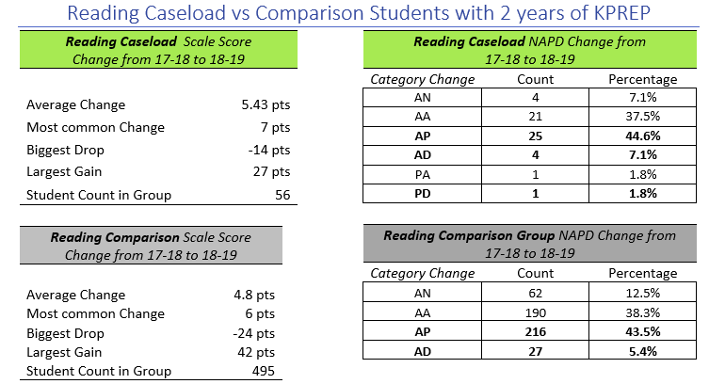

Slide 104
3,204

Slide 105
PS Remediation
GPRA 7B:
Number and percent of PN students who graduate with a regular high school diploma and obtain postsecondary degrees, vocational certificates, or other industry-recognized certifications or credentials without the need for remediation.
Notes:
VOTE

Slide 106
Decrease; target not met
Postsecondary
Remediation
2018 actual:
76.1% (-2.3%)
2019 actual:
68.2% (-7.9)
2019 target:
76.4%
2020 target:
77.4%
Additional info: Class of 2017: 78.4%
Notes:
This one is worded awkwardly. We actually want this one to increase because we are measuring the number of students who do not need remediation.

Slide 107
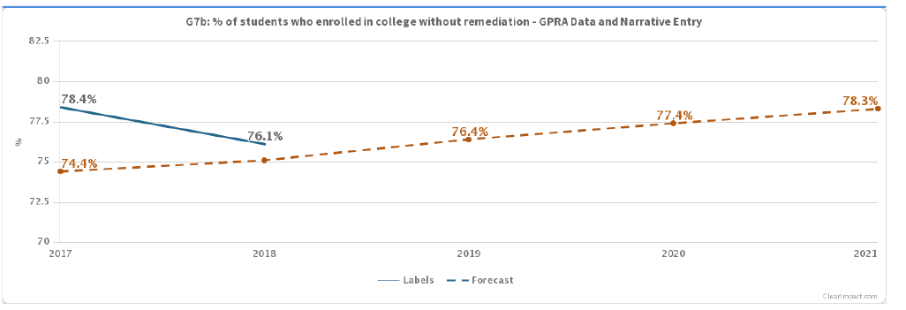
Visually…

Slide 108
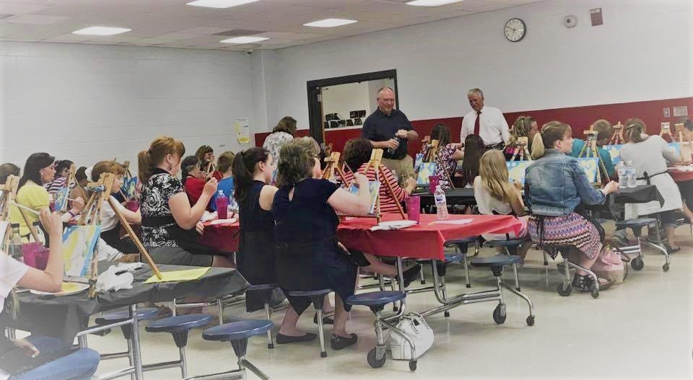
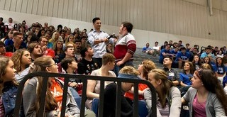
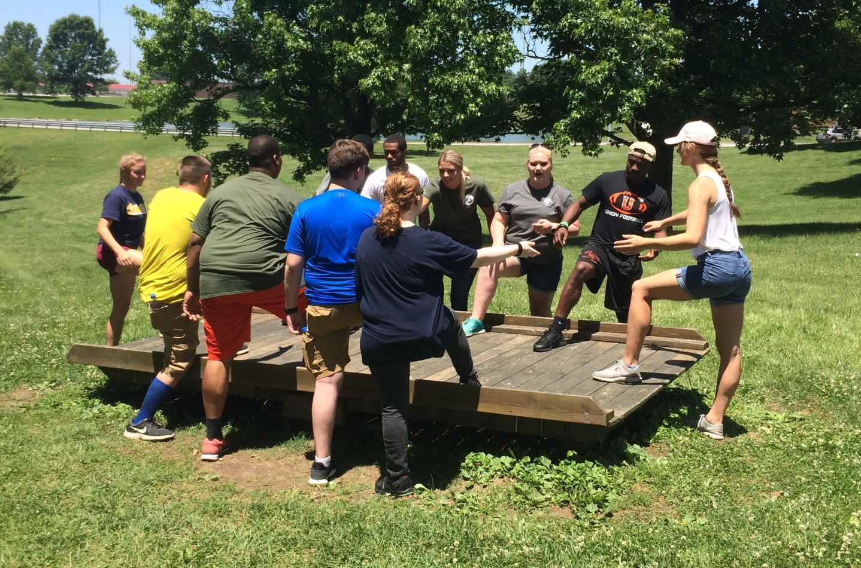
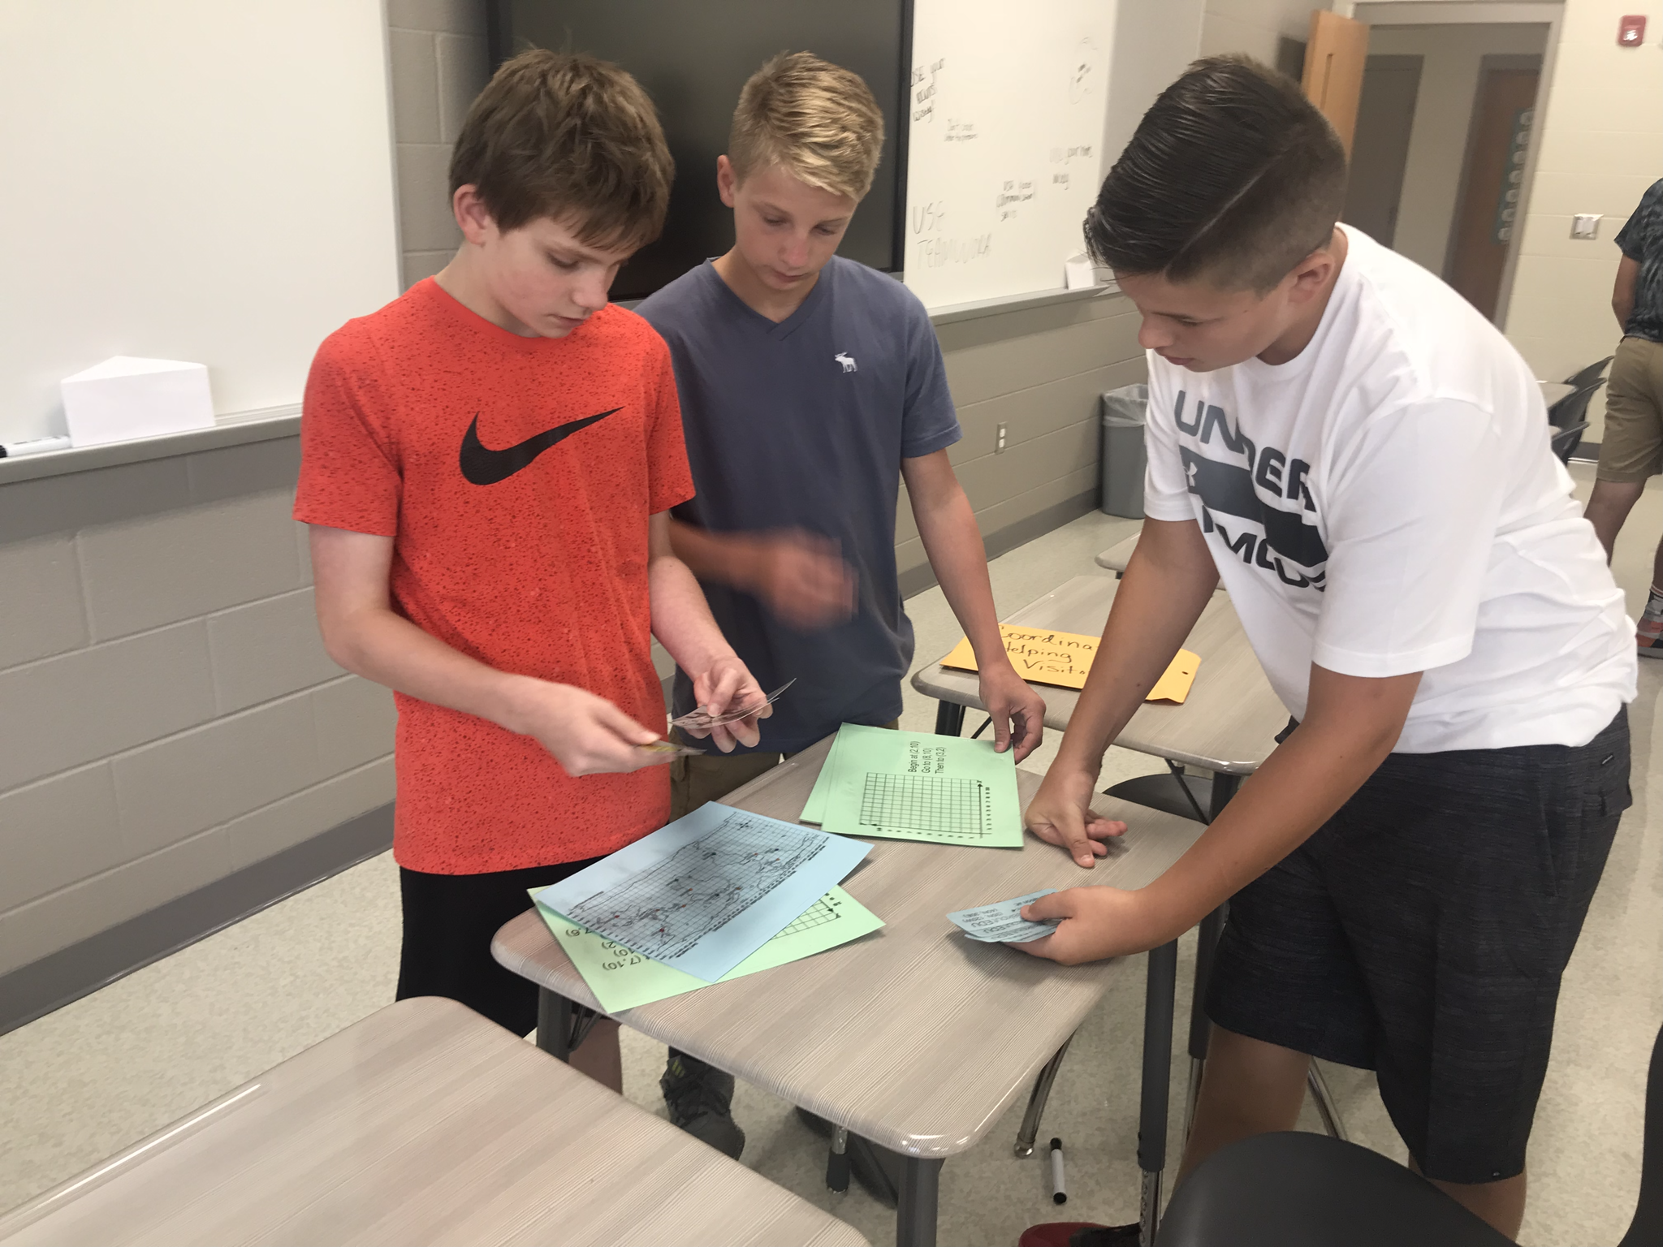
Wraparound

Slide 109
Attendance
GPRA 5A
Attendance rate of students in 6th-9th grade (ADA and chronically absent measures).
Notes:
VOTE
.
We pull this data directly from IC.

Slide 110
Increase and target met
ADA
2018 actual:
79.3%
2019 actual:
86.7% (+7.4)
2019 target:
80.8%
2020 target:
81.1%
Notes:
This actual will be updated at the end of the school year when we report on the entire year. These actual represent attendance from August through November 2018.
ADA saw the largest increases at the 6th and 7th-grade level. The smallest gains were at 9th grade, but every grade showed increases..

Slide 111
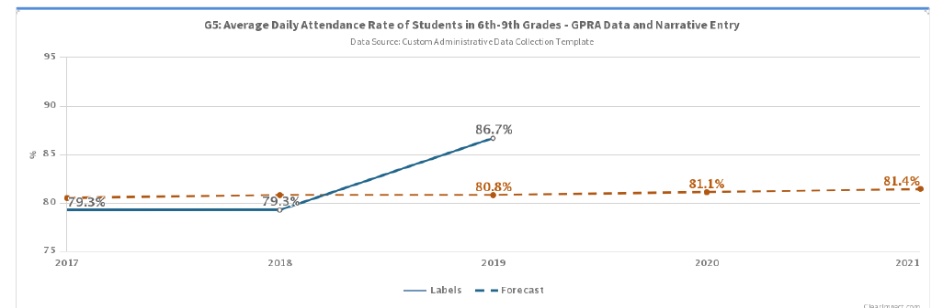
Visually…

Slide 112
Attendance
GPRA 5B
Attendance rate of students in 6th-9th grade (ADA and chronically absent measures).
Notes:
VOTE
We pull this data directly from IC.

Slide 113
Decrease; target not met
Chronic Absenteeism
2018 actual:
18.5% (-1.6%)
2019 actual:
17.7%
2019 target:
17%
2020 target:
16.9%
Notes:
Remember, we want chronic absenteeism to go down. This actual will be updated at the end of the school year when we report on the entire year. These actual represent attendance from August through November 2018. I am elated with this so far this year. I've worked in grant programs for a long time, and I have never worked in a grant that budged this number.
Largest decreases were at the 7th grade and 9th grade levels. We only saw an increase in chronic absenteeism in one grade--8th-grade.

Slide 114
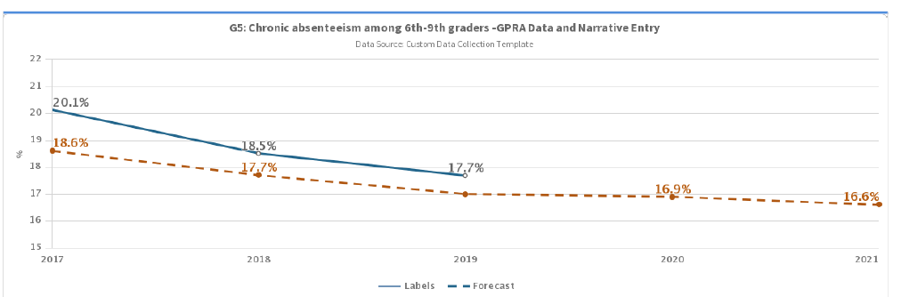
Visually…

Slide 115
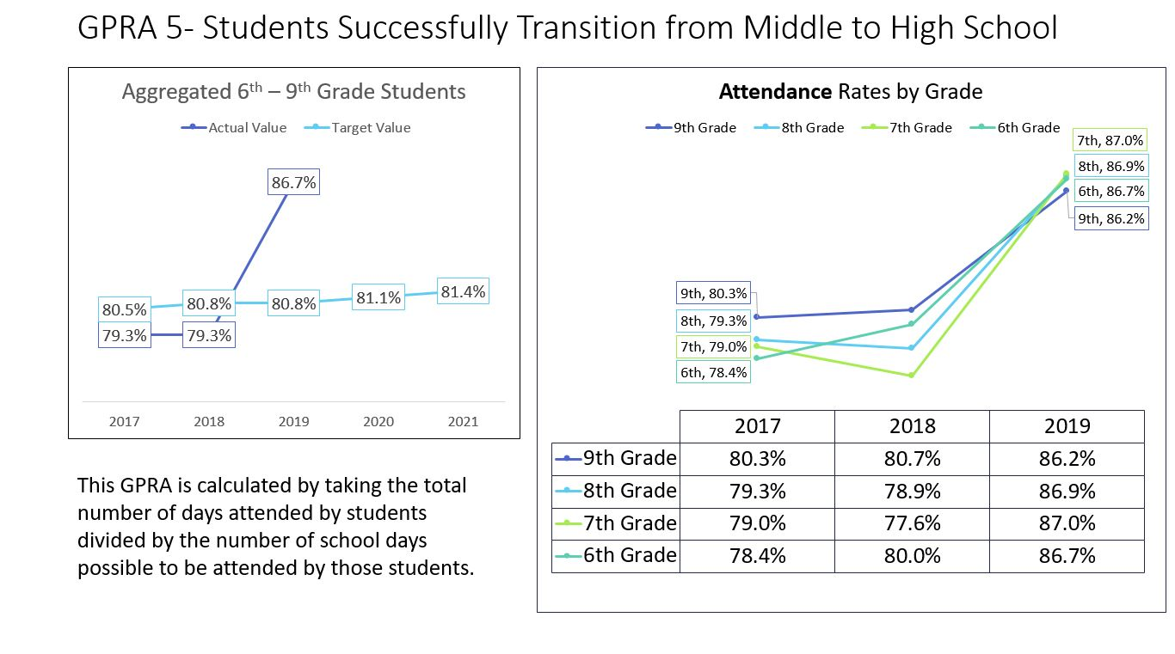

Slide 116
GPRA 5: Attendance rate of students in 6th, 7th, 8th and 9th grades

Slide 117
GPRA 5: Attendance rate of students in 6th, 7th, 8th and 9th grades (2018-19)

Slide 118
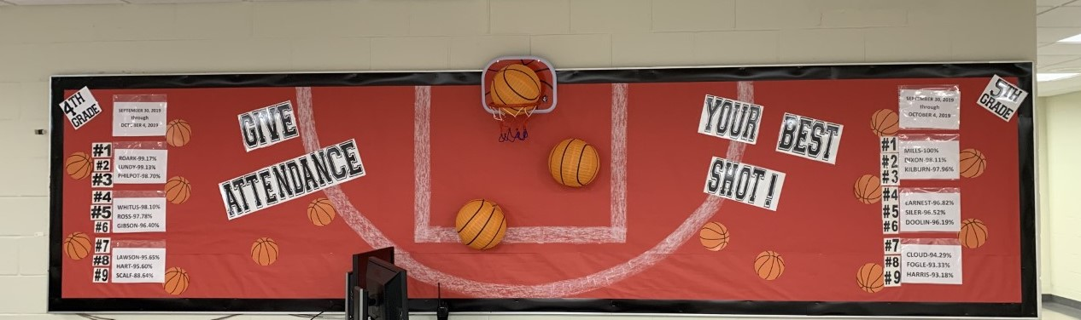
GPRA 5: Attendance rate of students in 6th, 7th and 8th grades
Years 1, 2 and 3
Years 4 and 5
Attendance letters home to chronically absent students
Magnets and calendars sent home to help parents track when their child is absent
Attendance pledges at schools
Focus groups with students who were chronically absent the previous year
FOR (Friends of Rachel) program targeting chronically absent students
Attendance competition boards
Weekly mentor meetings with students
Attendance Fu
Attendance kick-off
Chamber monthly movie passes
Continue sending attendance letters home in August
FOR club
Attendance pledges
Attendance boards
Attendance kick-off
Chamber monthly movie passes
Flyers and attendance information reminders sent through social media
Mentoring program utilizing the Self Esteem Garden curriculum

Slide 119
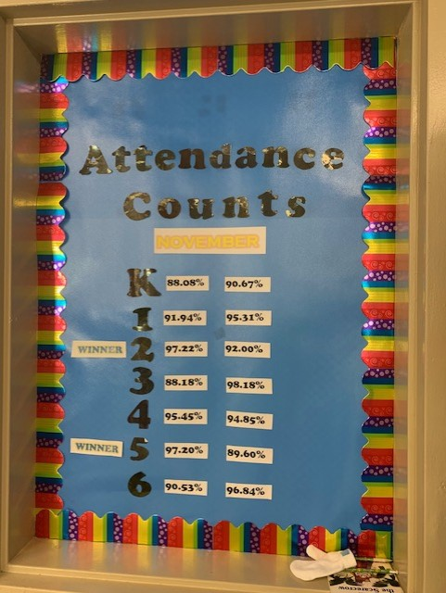
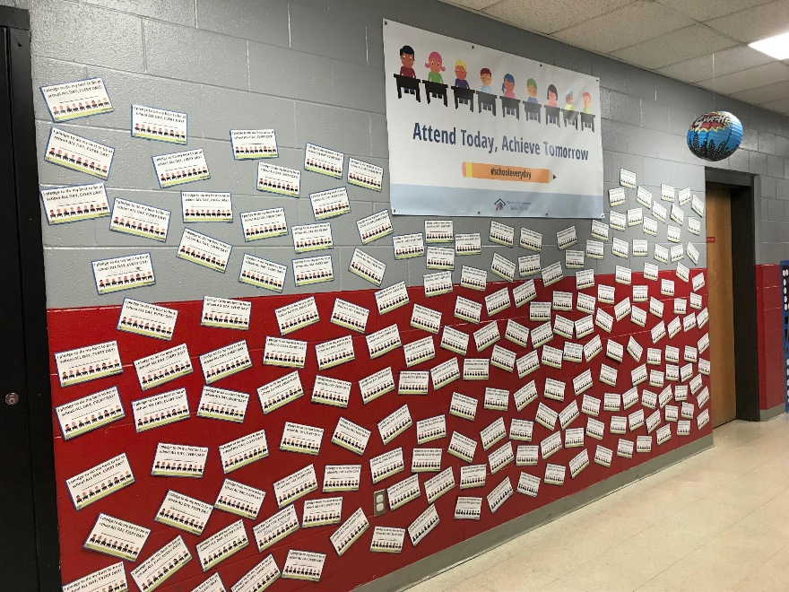
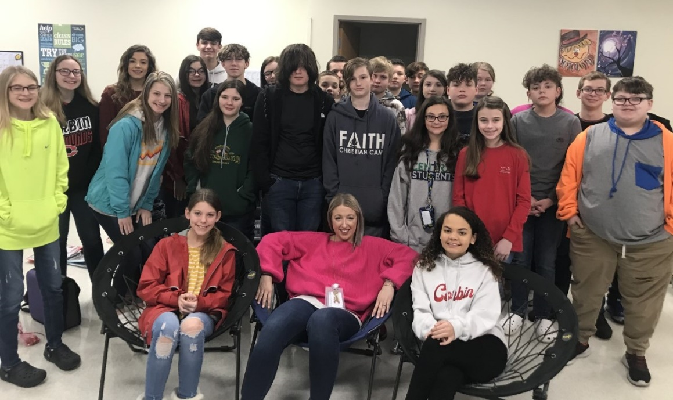
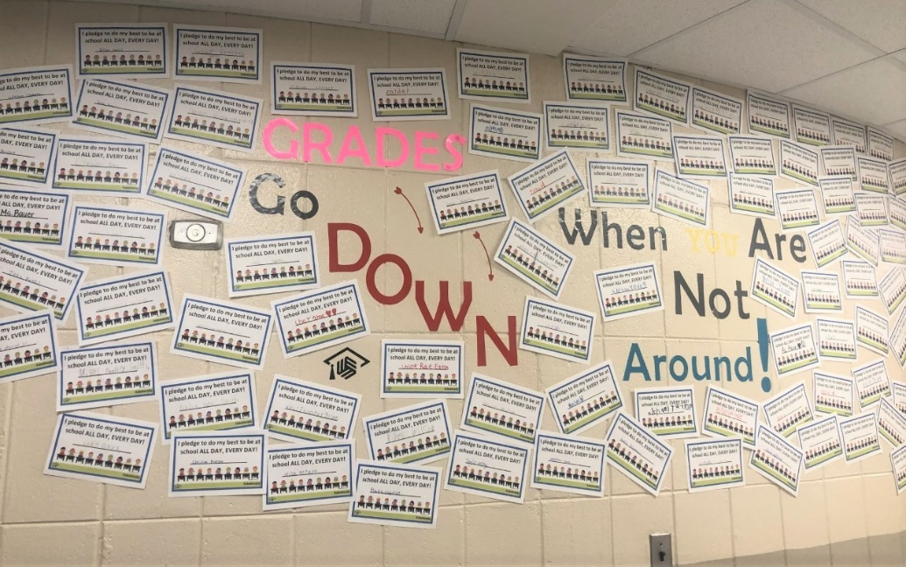
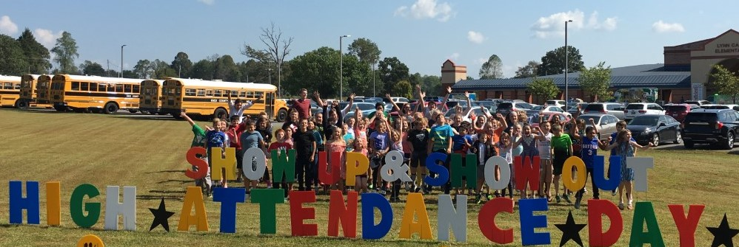
Attendance Matters!

Slide 120




Punch Out Low Attendance Rewards
Pie a Principal
Soak Mr. Lawson
Where in the World is Mr. Wilder?
Hoops with Mrs. Proffitt
Bubbles with Mrs. Beth
Jammin’ with Mrs. JeriKay
Magic with Mrs. Missy
Golden Microphone Karaoke
Story time with the Staff of Your Choice

Slide 121
PS Enrollment
GPRA 7A:
Number and percent of PN students who graduate with a regular high school diploma and obtain postsecondary degrees, vocational certificates, or other industry-recognized certifications or credentials without the need for remediation.
Notes:
VOTE
This data comes from the National Student Clearinghouse.

Slide 122
Decline; target not met
Postsecondary
Enrollment
Class of 2017 actual:
60.6%
Class of 2018 actual:
55.8%
Class of 2018 target:
67.5%
Class of 2019 target:
68.4%
Notes:
16-month window to report.

Slide 123

Visually…

Slide 124
GPRA 7a: # and % of PN students who graduate with a regular high school diploma, as defined in 34 CFR 200.19(b)(1)(iv), and obtain postsecondary degrees, vocational certificates, or other industry-recognized certifications or credentials without the need for remediation
Story Behind the Curve: Many programs became a fixture on the school calendars. Experiences became more meaningful and thoughtfully planned. No experiences were planned past December 1st to avoid cancellation.

Slide 125
GPRA 7a: # and % of PN students who graduate with a regular high school diploma, as defined in 34 CFR 200.19(b)(1)(iv), and obtain postsecondary degrees, vocational certificates, or other industry-recognized certifications or credentials without the need for remediation
Years 1, 2 and 3
Years 4 and 5
College Exposure
Ale 8 factory tour
Touring Lineman Schools
KY Coal Certification for alternative schools
WIOA
E-mentoring
Career Connection
Job Fairs
Partnership with KEAA-Financial Aid
Newton’s Attic-Engineering and STEM
Challenger Center-Math and STEM activities
Collaborate with AIs with BreakOut EDU
Expanding WIOA
Utilizing tech schools
Increasing exposure to Nepris
Job Fairs
Career Connection
Targeting caseload classes for career exploration
Continuing college tours/college exposure as well as virtual college tours
E-mentoring
Georgetown/Toyota tours
College Reality Fair
Reality Store with Knox Extension offices
Challenger Center-Math and STEM
Oak Ridge museum
Around Town Visits for elementary-(library, fire department, police station, courthouse)

Slide 126







College Exploration

Slide 127





College Exploration

Slide 128







Career Exploration

Slide 129






Career Exploration

Slide 130






Leadership Programming

Slide 131
Arts Integration
2019 Overview
Direct Services
Professional Development
Technical Assistance and Consultation
Resource Development
Looking Ahead

Slide 132

Direct Services
Targeting Indicators 4 and 7:
22 Arts Field Trips
20 Teaching Artist Residencies
6 Touring Arts Programs
9 Family Arts Events
Numerous special projects initiated by teachers and coordinators including:
  Lynn Camp School Wide Musical
  Knox Central High School Puppetry
  Corbin Primary “No Drama, Drama Camp”
Additional integrated services listed in CCR and other work plans
Photo by Frank Shelton: http://kcps.news/knox-county-middle-school-news/history-comes-alive-with-song-writing-at-knox-middle

Slide 133

Direct Services
2019 REACH Arts Services | Total students | # participating in PN arts activities this year* | % participating in PN arts activities this year*
Barbourville | 729 | 646 | 89%
Corbin | 2891 | 1876 | 65%
Knox Co. | 4515 | 2765 | 61%
Knox PN | 8135 | 5287 | 65%
The scope of Knox PN arts services grew from 28% of students in 2017 to 50% in 2018 and now 65% in 2019. This is not cumulative, meaning, coordinators have found ways to reach significantly more students in their schools each year.
* These numbers do not include arts-integrated activities that were entered into REACH with an activity type other than "Arts and Humanities"

Slide 134


Professional Development
2019 PD Workshops
Reading Writing and Puppetry with Squallis Puppeteers
Building Early Literacy and Math Skills with Sculpture
Arts + Math Pottery Workshop
Scholarships for Berea Learnshop Educator Packages

Slide 135

Professional Development
41 educators participated in 2019
Reached “moderate engagement” level with at least 10 new educators in 2019

Slide 136


Technical Assistance and Consultation
Kindergarten Readiness
Consultations with 3 KPN early learning centers (Crystal Reid and Sarah Campbell)
Academic Proficiency (and more)
TA to GRH and KAS to engage in Arts Connect Appalachian Youth project and regional summit
TA to KAS in implementing a VSA Grant to expand project (Larissa Beller)
College and Career Readiness
TA to KCHS for KY Arts Council TAT Grant (Robin Wright and Sarah Campbell)
Photo by Frank Shelton: http://kcps.news/knox-central-high-school-news/an-appalachian-connection-in-spanish-class

Slide 137



Resource Development
Expanded Teaching Artist Roster
13 new teaching artists selected and oriented to our work, including 4 from KPN service area: Sheila Herren, Rebecca Lankford, Jenn Riley, Krystle White
4 new/emerging teaching artists completed mentorships with highly experienced professionals
Commissioned Arts Integration Activity Guides
Developed by regional professionals
Created Conversation Starter Flyers
Curated Arts Integration Reading Material

Slide 138

Looking Ahead
High Quality Professional Development
Trauma Informed Education and the Arts
Math + Arts
Developing Early Literacy Skills with Drama
Stronger Working Relationships
Increase Arts Team presence in KPN offices and schools
Collaborate and strategize for high impact programming and sustainability
Braiding Integrated Strategies
2020 emphasis on Family Engagement

Slide 139
Exercise
GPRA 8:
Number and percent of children who participate in at least 60 minutes of moderate to vigorous physical activity daily.
Notes:
I'll show overall indicator levels; Rebecca will share school and district level data after me.
VOTE

Slide 140
Increase and target met
Exercise
2018 actual:
25.3% (+3.1)
2019 actual:
26.7% (+1.4)
2019 target:
23.9%
2020 target:
24%
Notes:
This GPRA is measured by the school climate survey—a survey of 7th-12th graders. WE had a very difficult time getting the required 80% completion on this survey this year, which I didn't expect because we had about a 90 percent completion in year 1.

Slide 141

Visually…

Slide 142


Slide 143
Eating Fruits & Veggies
GPRA 9:
Number and percent of children who consume 5 or more servings of fruits and vegetables daily.
Notes:
I'll show overall indicator levels; Rebecca will share school and district level data after me.
VOTE

Slide 144
Increase; target met
Fruit/Veg.
2018 actual:
18.5% (-1.4%)
2019 actual:
22.4% (+3.9)
2019 target:
21.5%
2020 target:
21.6%
Notes:
This is a tough measure to move as well because fresh fruits and vegetables are more expensive than prepackaged food. This is measured by the school climate survey in grades 7-12.

Slide 145

Visually…

Slide 146


Slide 147
GRPA 8: # and % of children who participate in at least 60 minutes of moderate to vigorous physical activity daily.
GRPA 9: # and % of children who consume five or more servings of fruits and vegetables daily.
Years 1, 2, and 3
Years 4 and 5
Get Movin’ with Operation UNITE
Café O Yeas
Yoga classes
Morning Walking club
Snap Ed Nutrition classes
New Fruit in the lunchroom tasting stations
Attendance Fu
Successful School Wellness Councils for CMS, LC, KCHS, Bville, KCMS
Cooking Camps
Gopher Beats
Kin Ball team building in PE
Continue to implement Café O Yeas
Fresh Fruit Fridays
Books and Bites
Zumba classes after school
Climbing Wall in PE
Tai Chi classes
Smoothie Snacks after school
Snap Ed nutrition cooking classes
Fitness Stations with goal setting in PE
Gopher Beats
Yoga Clubs
Virtual programming-videos of stretching, yoga and café O Yeas

Slide 148







Wellness

Slide 149

Work in Neighborhood
Where are we headed?
Spring 2019
  2,662 students reached; 227 faculty programs reached
  62 lessons taught; 597 students reached
  10 Café O Yea’s conducted
  1 club (cooking club)
  2 School-wide health fairs reaching over 1,000 students
  3 School-wide wellness councils in place
Fall 2019
  3,179 students reached; 390 faculty programs (appreciation) reached
  97 Classroom lessons taught; 589 students reached
  17 COYs conducted
  4 clubs (cooking club, fitness club, yoga club, garden club)
  2 School-wide wellness councils in place
  2020
    24 Cafe O Yea kits are available to check out in each PN office. Café O Yeas are 5 minute demonstrations that are fun and interactive which provide the opportunity to quickly learn a new health-related skill. These are usually offered to students during lunch, gym or health times
    School health advocates and PN coordinators are responsible for school (middle/high) and district (elementary) wellness councils
  2021
    Café O Yea implementation
    HealthCorps Connect-All schools in Knox PN will continue to be provided with online guidance from the professional staff at HealthCorps. Coordinators will be responsible for getting this information to the health champions and students at their schools.

Slide 150
Students feel safe
GPRA 10:
Number and percent of students who feel safe at school and traveling to and from school.
Notes:
I'll show overall indicator levels; Rebecca will share school and district level data after me.
VOTE

Slide 151
Decrease; target not met
Safety
2018 actual:
75.8% (-2%)
2019 actual:
69.1% (-6.7)
2019 target:
78.8%
2020 target:
79.5%
Notes:
Again, this is measured by a school climate survey of 7th-12th graders. The traveling to school part of the measure is what I consider an urban measure although there are kids who don't feel safe in the parents' cars or on the bus. This decreased of 2% was not unexpected. Our 2017 school climate survey was administered before the 2018 school shootings and before our schools had metal detectors.

Slide 152

Visually…

Slide 153


Slide 154
GPRA 10: # and % of students who feel safe at school and traveling to and from school, as measured by a school climate needs assessment.
The Story Behind the Curve
Years 1, 2 and 3
Questions are not detailed in the School Climate Survey on which we base our data.
  Question 17- To what extent do you agree or disagree that this school is a safe place for students?
  Question 18-To what extent do you agree or disagree that you are safe when traveling to and from school?
Social Media is easy to access where student fall victim to cyberbullying, or predators, or watch school shootings. Students are more aware and even have mock shootings to remind them several times per year.
Most Knox PN schools do not have research-based anti-bullying programs
Trained school staff in 2017 in Teen Outreach Program (TOP)
Incorporated Green Dot into Lynn Camp and Barbourville Schools
Anti-bullying speakers and assemblies
Friends of Rachel (FOR) kick-off with students and community
Internet Safety for teachers, parents, and students
Allowing leadership team members to be the spokespeople for safety awareness in their schools
Self Defense classes
Operation UNITE
Stomp Out Bullying programs
Moving the Dial in Years 4 and 5
Friends Of Rachel (FOR) club curriculum implementation
Training coordinators and teachers in WhyTry and Resilience for Youth programs
Teen Outreach Program (TOP)-Kayla Hubbard is now a train the trainer
Trauma Informed Care trainings
Continuing Internet Safety programs for students
Self-Esteem/Awareness curriculum offered to targeted students
Looking into LinkCrew program
Creating focus group with targeted questions to delve deeper into survey questions.

Slide 155
Safety and Wellness Data

Slide 156









Safety

Slide 157




Too Good for Drugs
UNITE Too Good for Drugs to 4th grade classrooms
  2017-382 students reached
  2018- 404 students reached
  2019 – 460 students reached
UNITE Clubs
  2016-2017; 76 members
  2017-2018; 1008 members
  2018-2019; 1347 members
  2019-2020; 1604 members
Mendez Too Good for Drugs curriculum empowers students with the social-emotional learning and substance abuse prevention skills they need to lead happy and healthy lives. The lessons teach students how to handle peer pressure, stress, and provide real-life examples and situations to teach students to avoid make bad decisions.
The pre and post surveys each year depict the significant change and impact the students gain in understanding drug abuse, mental resilience, and the ability to make better decisions.

Slide 158
Teen Outreach Program
Safety and Wellness

Slide 159
What is TOP?
Wyman’s Teen Outreach Program (TOP) promotes the positive development of adolescents through curriculum-guided, interactive group discussions; positive adult guidance and support; and community service learning.
TOP is delivered by trained adult facilitators across a nine month period to groups of teens (called “TOP Clubs”).
TOP is designed to meet the developmental needs of middle and high school teens and can be implemented in a variety of settings, including: in-school, after-school, through community-based organizations or in systems and institutional settings (i.e. residential facilities)
The TOP Curriculum is focused on key topics related to adolescent health and development, including: building social, emotional, and life skills; developing a positive sense of self; and connecting with others.

Slide 160

Why top?

Slide 161

Where is the top program active?
Knox Central High
Lynn Camp Middle and High schools
Appalachian Children's Home
Corbin Educational Center

Slide 162

How can you help?
See if your school wants this program
Can it be sustainable?
Do you have staff that want to be trained?
How can we expand?

Slide 163
PS Enrollment
GPRA 7A:
Number and percent of PN students who graduate with a regular high school diploma and obtain postsecondary degrees, vocational certificates, or other industry-recognized certifications or credentials without the need for remediation.
Notes:
VOTE
This data comes from the National Student Clearinghouse.

Slide 164
Decline; target not met
Postsecondary
Enrollment
Class of 2017 actual:
60.6%
Class of 2018 actual:
55.8%
Class of 2018 target:
67.5%
Class of 2019 target:
68.4%
Notes:
16-month window to report.

Slide 165
Visually…

Slide 166
PS Completion
GPRA 7C:
Number and percent of PN students who graduate with a regular high school diploma and obtain postsecondary degrees, vocational certificates, or other industry-recognized certifications or credentials without the need for remediation.

Slide 167
No data
Postsecondary
Completion
Notes:
As of January 2019, we did not have any students who would have received an associate's or four-year college degree because our first high school graduating class was the class of 2017. (100 to 150 percent of traditional time; 3 years associate's; 6 years bachelor's)

Slide 168
Visually…

Slide 169
PS Certification
GPRA 7D:
Number and percent of PN students who graduate with a regular high school diploma and obtain postsecondary degrees, vocational certificates, or other industry-recognized certifications or credentials without the need for remediation.
Notes:
VOTE

Slide 170
New data; no target
Certificate Completion
Class of 2017 actual:
12
Class of 2017 target:
00.00%
Notes:
This one is a hard one to compare this time of year because we give students 16 months to enroll in postsecondary, and our 2018 students have not met that threshold yet.
To give you a little history, at this time last year, our data showed the 2017 grads were enrolled at 49.3%, so we are up 0.4% over that. Since that time, though, many of our 2017 graduates have enrolled in college, increases their enrollment rate to 60.5%; however, that is still short of our target. Some of our coordinators reached out to graduates over the summer to encourage them to attend college. We saw a big increase in enrollment after that, so we encourage you to do that again this year. I gave this one a yellow light even though we had a slight increase in enrollment because we were several points shy of meeting our target last year and the 0.4% is not enough to get us to the 2019 target. In short, we must do more than we did last year to reach our target.

Slide 171
Promise Scholars Program
Designed to prepare students to succeed in college
Community of scholars
Postsecondary navigator dedicated to student success
Give students skills and tools for success

Slide 172
Promise Scholars Benefits
Laptop
Offers supportive community
Social events
Workshops
Considered for internships
Family engagement

Slide 173
Postsecondary Navigators
Eastern Kentucky University, Amy Floyd
Morehead State University, Tammie Sanders
Somerset KCTCS, Tammie Sanders
Southeast KCTCS, Tammie Sanders
Union College, Glenn Baker
University of the Cumberlands, Korey Bruck

Slide 174
Promise Scholars Commitment
Application—online (May 29 deadline)
Two transition workshops
Meet PSN virtually
Attend summer orientation
Must attend partner college

Slide 175
Promise Scholars Commitment
When students arrive on campus in the fall, they receive computer
Complete PSN workshops during fall semester
Community service
Attend social event

